Slide 1

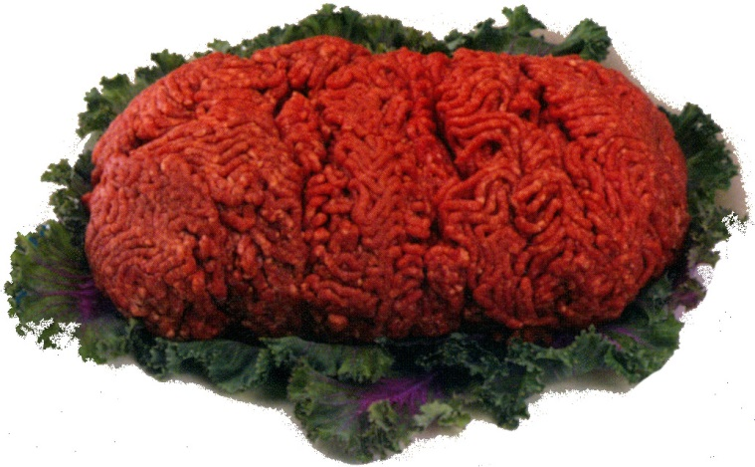
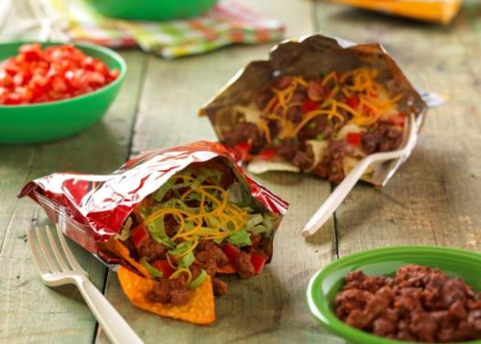
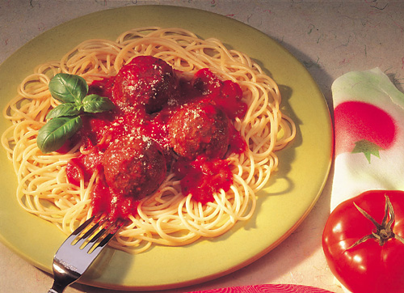
Ground Beef 101
Notes:
Ground Beef is a very versatile food. It can be used in a variety of dishes from one-skillet meals, appetizers, breakfast, tailgate parties or burgers for the grill.
Ground Beef is one of the most versatile types of protein sources with endless recipe options in the kitchen.
Let's learn the basics of Ground Beef.

Slide 2

Do You Know the Difference?
Ground beef
Hamburger
Beef patties
Notes:
2
When you purchase Ground Beef, you may find different choices. Be sure to read the label to ensure you are buying the best type of Ground Beef for your intended purpose.
Ground Beef -
-chopped fresh and/or frozen beef muscle
-less than 30% fat
-no added seasonings, water or extenders
Hamburger -
-may have added beef fat, seasonings but no water, phosphates, extenders or binders added
Beef Patties-
-may have added ingredients as labeled

Slide 3
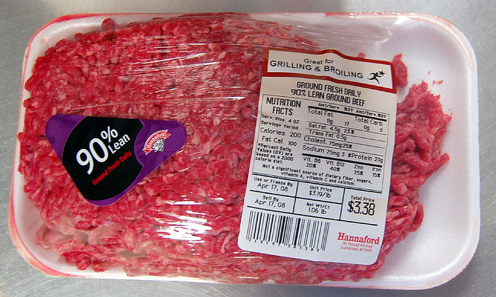
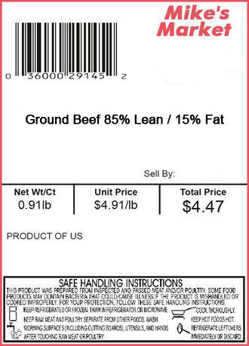
It's All On the Label
The label will indicate:
--Net weight
- Unit price per pound
- Total price
Notes:
3
Understanding the label is an important consumer skill. The labeling of meat products must comply with the Federal Meat Inspection Act (FMIA) and follow meat inspection regulations and labeling policies.
USDA (United States Department of Agriculture) Food Safety and Inspection Service is responsible to ensure that meat products are wholesome, unadulterated, and correctly labeled and packaged.
Meat grades are assigned as a standard of quality only. It is voluntary for a company to hire a Federal Grader to certify the quality of the product. Meat inspection is mandatory.
USDA – inspected plants have Sanitation Standard Operating Procedures that cover policies such as the cleaning of grinding machines and the handling and chilling of ground beef. It is important that stores and consumers follow stringent sanitary procedures.
The label will indicate the net weight measured in pounds for the entire package. The unit price means the cost per pound of the Ground Beef. The total price is shown on the package and determined by multiplying the net weight times the unit price in each package.

Slide 4
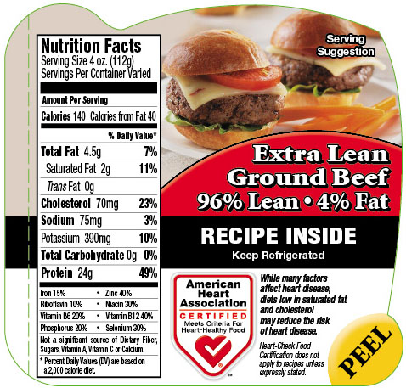
Understanding the Label
96% Extra Lean means
96% lean muscle and 4% fat
The higher % lean = less fat
Lean to Fat Ratio-
Notes:
4
Consumers can save money by knowing how the Ground Beef will be prepared.
You will find many Ground Beef choices in the meat case that vary from 70% to 96% lean. You may find Ground Chuck or Ground Round, which indicates the beef primal that they were made from.
The percent lean is the lean to fat ratio which compares the amount of lean muscle to fat. For example, 96% lean means it is 96% lean muscle and 4% fat.
Price-conscious consumers can purchase 80% lean ground beef, fully brown the beef in a skillet and rinse the beef crumbles in a colander with VERY HOT water. This extra step will eliminate some fat.

Slide 5
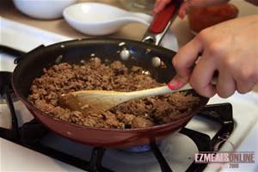
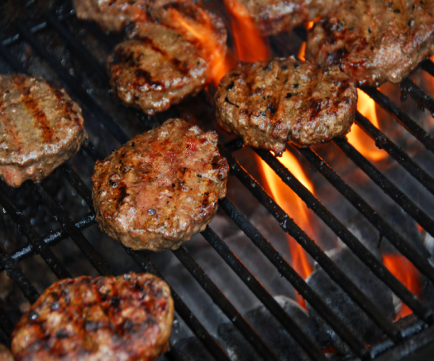
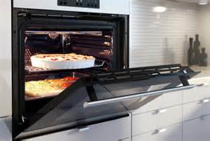
Recommended Cooking Methods
Skillet
Grill or Broil
Oven
Notes:
5
The different Ground Beef choices lend themselves to one of the three cooking methods.
70 to 75% lean works great when crumbled and browned in a skillet; the fat can be drained and the crumbles can be used in dishes such as tacos and chili.
Grilling or broiling is great for 80-85% lean Ground Beef patties. Meat loaf and meatballs can also be baked in the oven.
90-96% lean is a good choice when you are limiting fat in your diet. Be careful not to overcook the leaner Ground Beef as it can dry out.

Slide 6
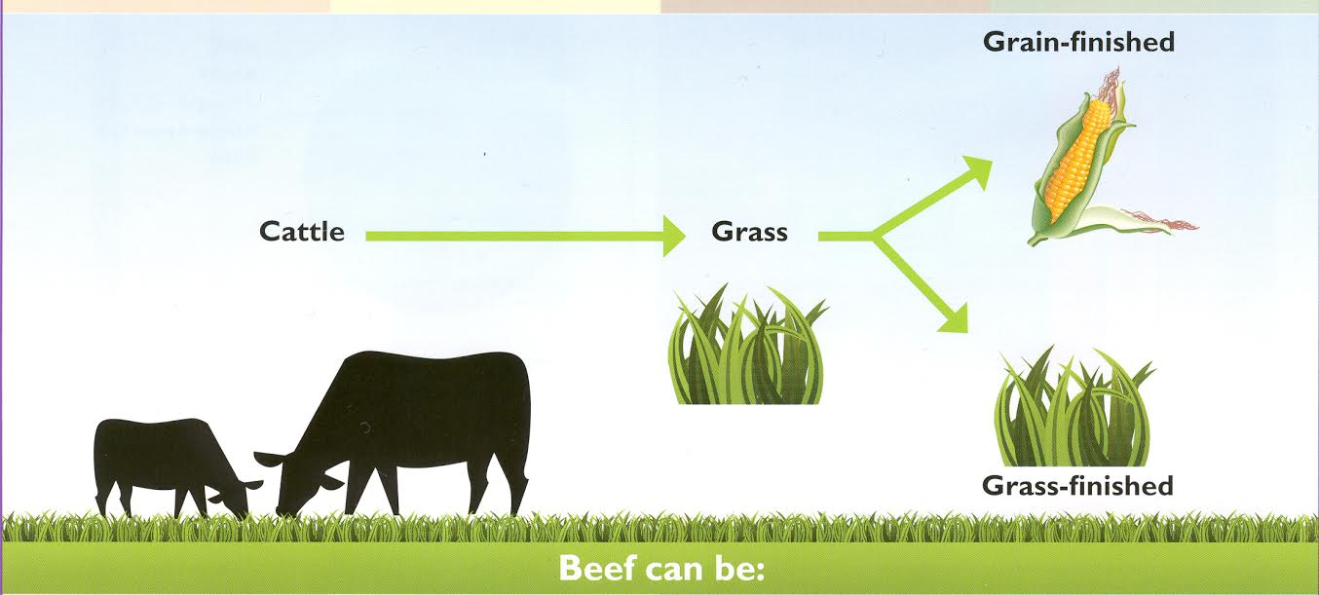
Production Basics
Notes:
6
Understanding the basics of beef production can help consumers better understand where their food comes from and how it is produced.
All cattle eat grass for part of their lives and may be “finished” on either grass/pasture/forage or grain/corn. (Finished is when the calf is weaned from the cow and is fed to gain weight for market.)
In the northern states, we have winter and snow, which means the grass does not grow year round! These weather conditions require farmers to have enough hay to bale during the summer months to provide grasses for the winter (about 6 months in Iowa).
Most farmers also feed the animals grain (corn) to help the animals gain lean muscle sooner and because the quantity of hay required to feed the cattle during the long cold winter.

Slide 7
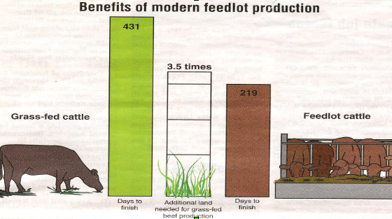
Environmental Impact
Compare the Differences
Notes:
7
In terms of sustainability, grain-finished cattle have less impact on the environment because they are ready for market sooner. Grain/corn provides carbohydrates and energy for the animals to gain muscle quicker. Grain is more energy-dense than grass, so the cattle grow more quickly and are ready for market sooner.
In Iowa, we also feed the co-products from ethanol production. We make fuel (ethanol) and the remaining products are called distiller's grains which make a good feed for cattle.
Cattle are ruminants with a 4-part stomach that allows them to digest grass, hay, cornstalks etc., that humans cannot digest. They create nutrient-rich beef and milk for humans. When ruminants digest the forages, the cattle give off methane gas. Methane is s type of greenhouse gas. The longer the animal lives, the more methane gas given off.
Grain-fed cattle have less environmental impact because they have a shorter lifespan and will produce less methane gas. Grain-fed cattle may be ready for market more than 200 days earlier than grass-fed cattle and require a significant less amount of land to graze.

Slide 8

Beef Is Part of a Healthy Diet
Beef is a complete protein food.
Beef has nutrients important for health.
Beef has 10 essential nutrients!
Notes:
8
Ground Beef is an excellent source of protein and can fit into the Protein section of My Plate.

Slide 9

Beef Scores Big with Nutrients
Iron
Choline
Selenium
Zinc
Phosphorus
Protein
Vitamin B6
Vitamin B12
Niacin
Riboflavin
Notes:
9
Beef scores a perfect “10” with the ten essential nutrients that each serving contains. These nutrients are important for normal body functions.
Protein-helps preserve and build muscles
Vitamin B6 and Vitamin B12-help maintain brain function
Niacin-supports energy production and metabolism
Riboflavin-helps convert food into fuel
Iron-helps your body use oxygen
Choline-supports nervous system development
Selenium-helps protect cells from damage
Zinc-helps maintaining a healthy immune system
Phosphorus-helps build bones and teeth

Slide 10
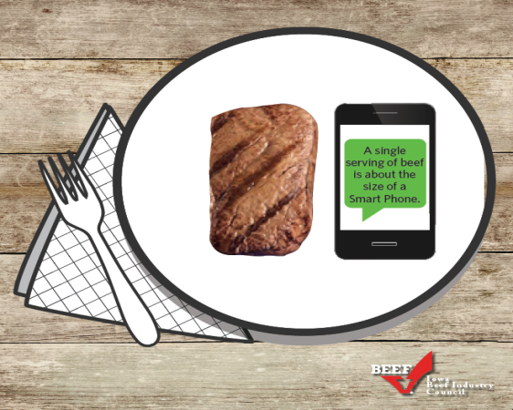
Packed with Protein
One 3 oz. Serving = the size of a small iPhone.
3 ounces of ground beef provides ½ the daily value for protein.
Protein helps build and repair muscle tissue.
Notes:
10
Protein is an important nutrient in a healthy diet.
A 3 oz. serving of lean beef provides 25 grams of the Daily Value for protein. One 3 oz. serving is about the size of a small iPhone.
Exercise and protein work together to build a healthy, lean body. Ground Beef is one of those good sources of protein.

Slide 11
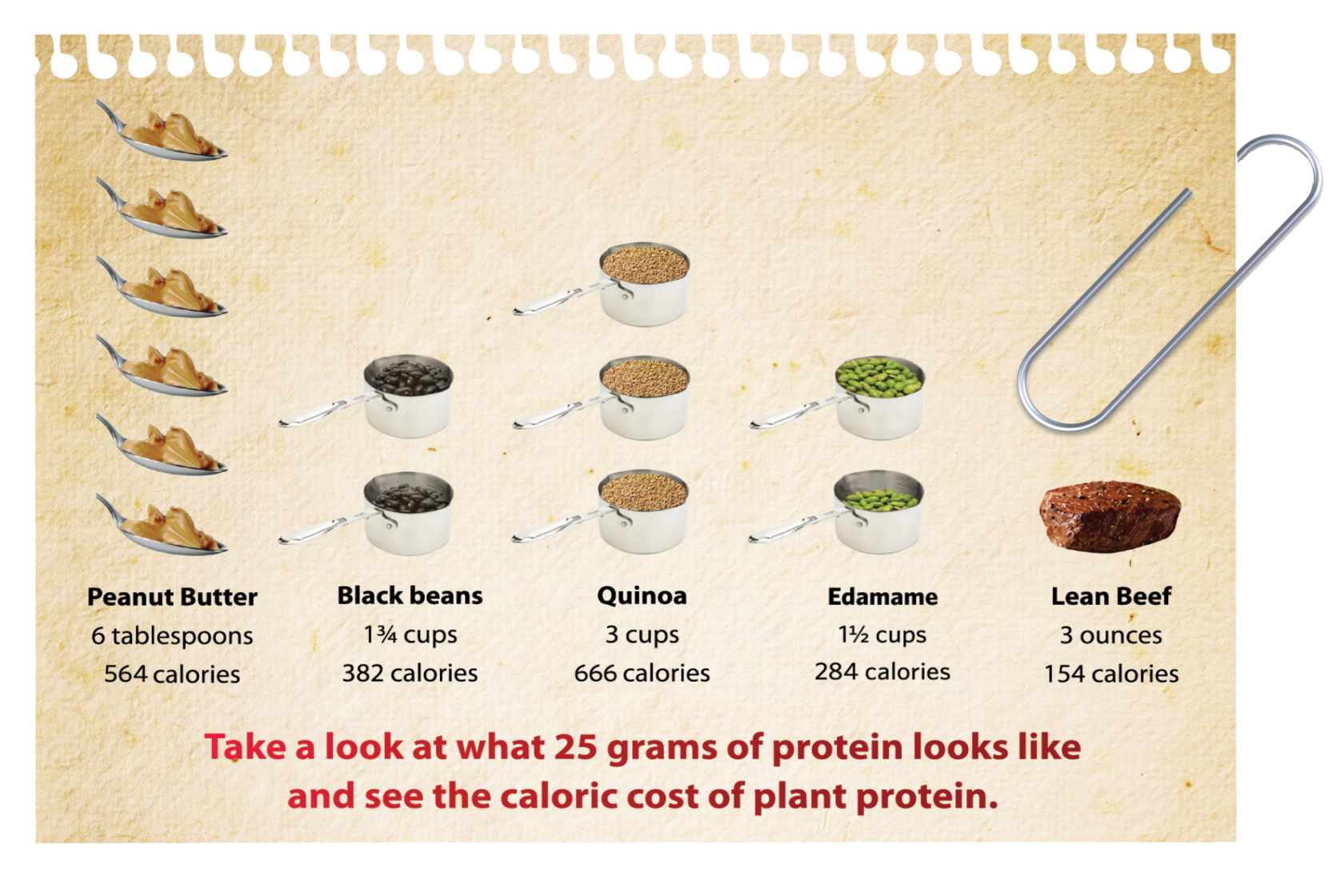
Plant vs. Lean Beef Comparison
Notes:
Take a look at what 25 grams of protein looks like compared to other protein sources.
Compare the calories consumed to get the same amount of protein.
One 3 oz. serving of lean beef has just 155 calories compared to some of the other foods shown.
Lean beef can be an important part of a healthy diet.

Slide 12

How to Handle Beef Safely
  Proper and safe handling of ground beef can help prevent food borne illness.
    Cook
    Clean
    Chill
    Separate
Notes:
12
Bacteria is everywhere in our environment. Proper handling, storage and preparation of foods can help prevent food borne illness. If pathogens (illness-causing) bacteria are present when meat is ground, then more of the meat surface is exposed to the harmful bacteria.
Grinding allows any bacteria present on the surface to be mixed throughout the meat. Bacteria multiply rapidly in the Danger Zone ( temperatures 41 – 135 degrees F ), so proper cooking is important.

Slide 13

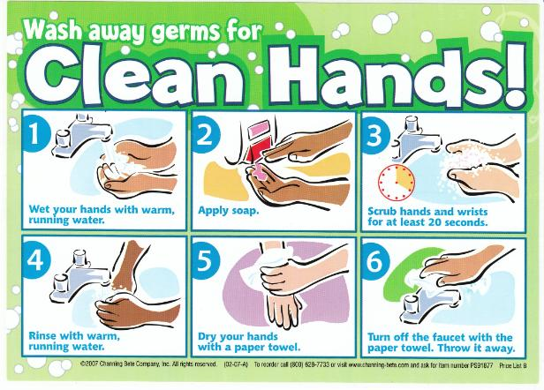
Clean
Wash hands and surfaces often with hot soapy water.
Notes:
13
Washing hands, counter tops, surfaces and equipment used in preparing food can help prevent food borne illness.
You should NOT wash raw beef before cooking it. Any bacteria which might be present will be destroyed by cooking to 160 degrees F internal temperature.

Slide 14


Chill
After purchasing, refrigerate Ground Beef immediately at 40 degrees F.
Use within 1-2 days or
Freeze
Notes:
14
Beef is a perishable product. It is important to keep it cold to slow down the growth of bacteria. Refrigerate beef and use within 1 to 2 days for ground beef and 3 to 5 days for other cuts or freeze at 0 degrees F.
It is safe to freeze in its original packaging or repackage it. For long term freezing, over-wrap the porous store plastic with aluminum foil, freezer paper or freezer weight plastic wrap or bags to prevent “freezer burn”.

Slide 15
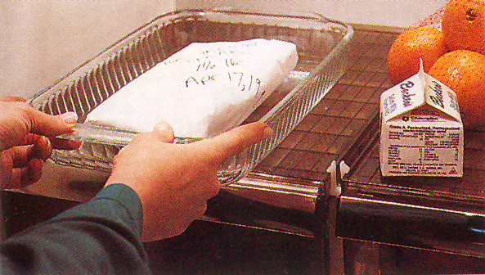
Safe Defrosting
1. Refrigerator
2. Cold Water
3. Microwave
Notes:
Safe Defrosting- There are three safe ways to defrost beef; in the refrigerator, in cold water and in the microwave. Never defrost on the counter top or in other locations.
Refrigerator- It's best to plan ahead for slow, safe thawing in the refrigerator. It should defrost within 24 hours. Once defrosted, use the meat within a day or two.
Cold Water- To defrost in cold water, do not remove packaging. Be sure the package is airtight or place in an airtight bag. Submerge the beef in cold water, changing the water every 30 minutes. Small packages should defrost within an hour or less.
Microwave-When microwave defrosting, plan to cook the beef immediately because some areas of the food may become warm and begin cooking.
Holding partially-cooked beef is not recommended because any bacteria present may not have been destroyed.

Slide 16

Separate
Raw meats from other foods
Use clean knife and cutting board
Do Not Cross Contaminate!
Notes:
16
Use a separate cutting board and knife when handling raw vegetables and meat to help prevent cross contamination.
Select beef just before checking out at the register. Put packages of raw beef in disposable plastic bags to contain any leakage. Keep raw meat separate from other foods in your shopping cart and grocery bags.

Slide 17

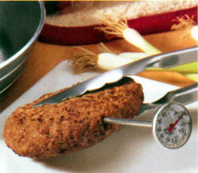
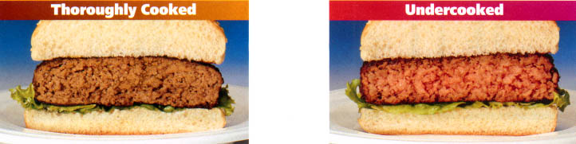
Cook
Cook to internal doneness of 160º F.
Be sure juices and centers are not pink
Never eat undercooked or raw Ground Beef
Notes:
17
When preparing ground beef, proper cooking temperature can prevent the growth of bacteria. Use a thermometer to ensure the meat has reached an internal temperature of 160 degrees F.
Use cooked beef within 2 hours (one hour if the air temperature is above 90 degrees F) or refrigerate the meat at 40 degrees F in shallow covered containers. The meat should be eaten within 3-4 days, and reheated to 165 degrees F.
It is safe to freeze already-prepared beef dishes. For best quality, use within 4 months.

Slide 18
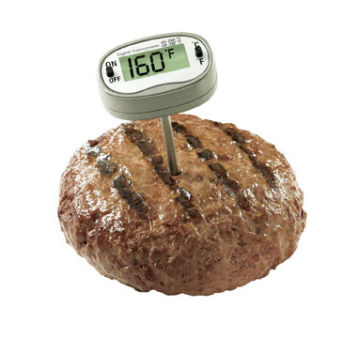
How to Check Meat Temperature
https://www.youtube.com/watch?v=PsoPhA93J9k&feature=youtu.be
Notes:
18
This video link show how to correctly use a meat thermometer.

Slide 19

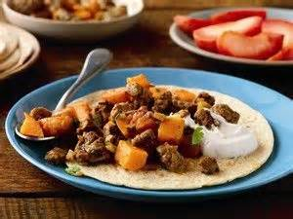
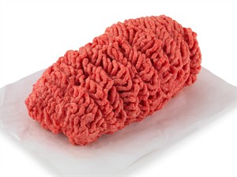
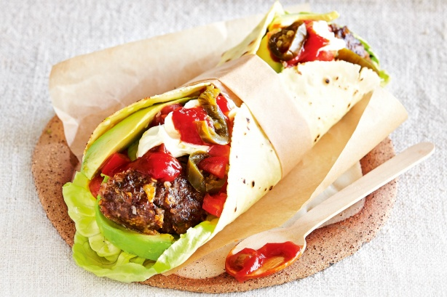


Economical, Versatile
and Tasty – Ground Beef
Notes:
19
Ground Beef is economical, versatile to use and packed with 10 nutrients needed everyday. Preparing tasty recipes with ground beef is sure to please any family or crowd.

Slide 20
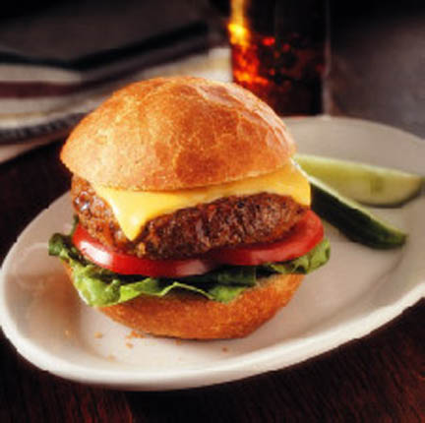
Choose Ground Beef for Your Plate!
Understand the basics!
Notes:
20
Ground Beef is a nutrient-dense protein choice. Understanding the basics of Ground Beef will make you a wise consumer. Choose Ground Beef for your Plate.

Slide 21

Ground Beef 101
Prepared by Kristie Kuhse, M Ed.
Family and Consumer Sciences Teacher, Waverly-Shell Rock Middle School
Brought to you by Iowa’s beef farmers through the Beef Checkoff Program
www.iabeef.org

