Slide 1

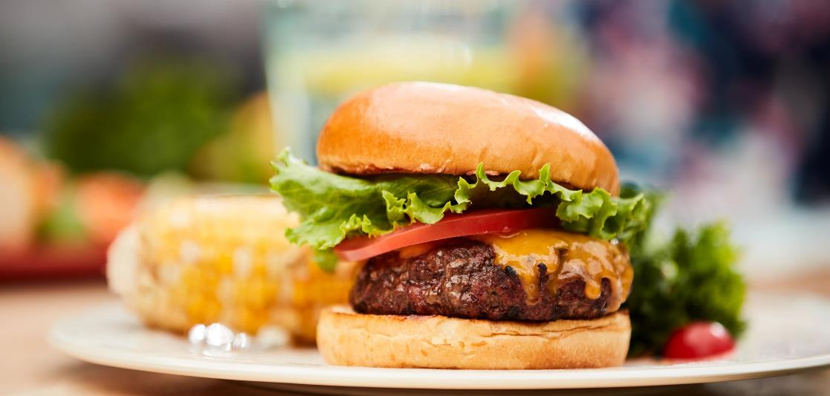

My Cheeseburger Came
From the Farm
Cheeseburger from a farm? How can that be?

Slide 2
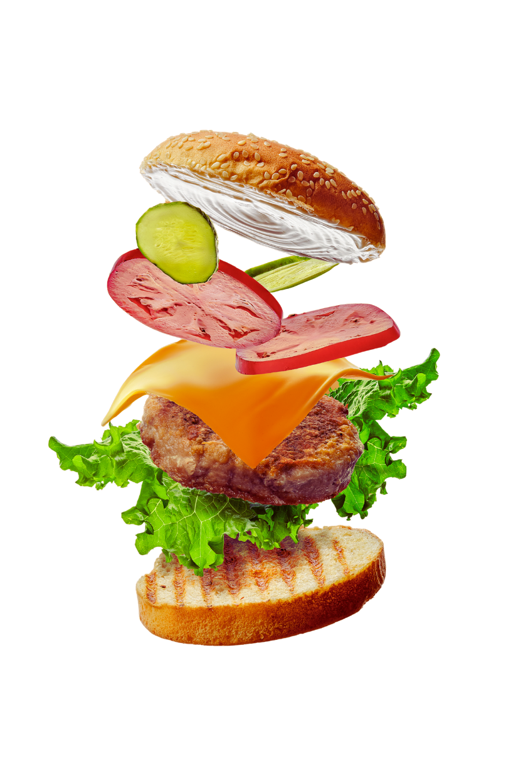


The Food
From Where?
bun
wheat
pickle
cucumber
tomato
tomato
cheese
dairy cattle
hamburger
beef cattle
lettuce
lettuce
The ENTIRE cheeseburger is grown by farmers.

Slide 3
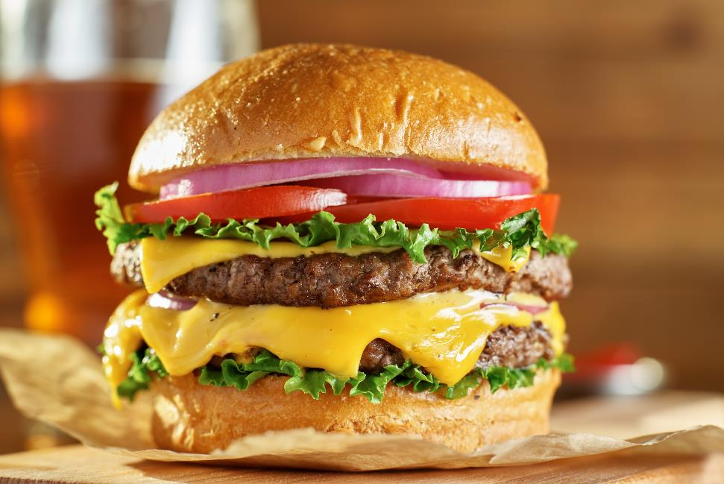

Ground beef and cheese are used to make cheeseburgers.
Both beef and cheese come from cattle.

Slide 4
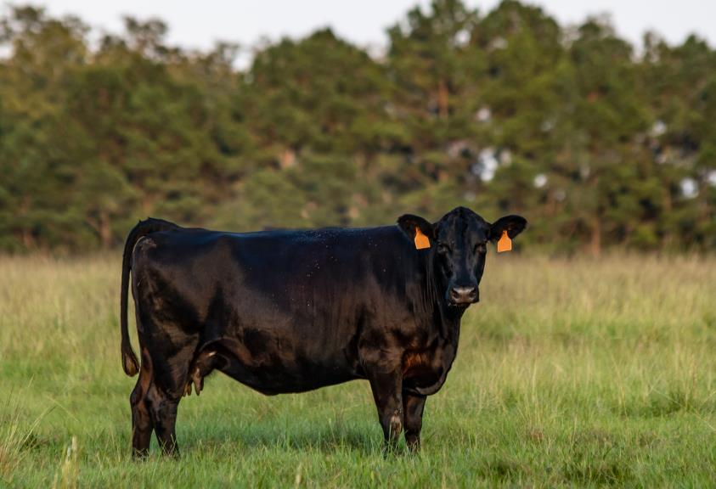

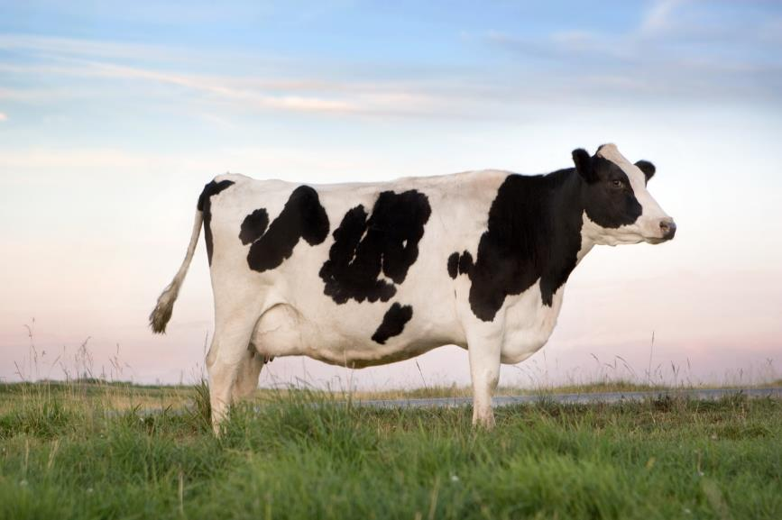
beef cow
dairy cow
Farmers raise some cattle to give us milk and other cattle to give us meat. Cheese is made of milk from dairy cattle. We get ground beef from beef cattle.
Notes:
Beef and Dairy animals are often confused. They are both cattle, but have different purposes and different body structure. Beef cattle are raised to provide meat. Dairy cattle are raised to primarily provide milk. When dairy cattle “retire” or quit producing milk, they provide beef, too.

Slide 5
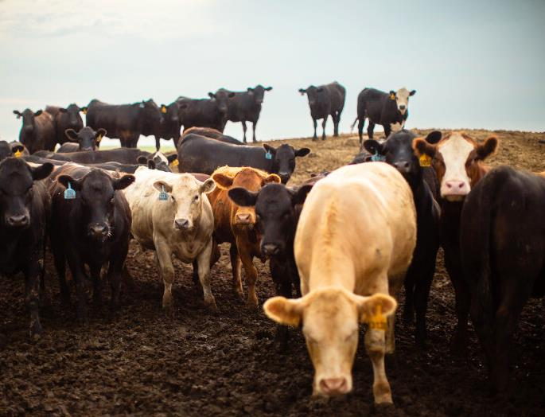

Just like people, cattle come in different colors, shapes and sizes. A group of cattle is known as a herd.
Notes:
Breeds are cattle of the same background and have similar characteristics, like color. There are over 70 different breeds of cattle. There are red, yellow, black, white, and gray cattle. Some have horns, but most do not. Cattle without horns are called “polled”. When you say “cow”, children often think of black and white spotted cattle which are the Holstein dairy breed. That is one type, but there are hundreds of different colors of cattle.

Slide 6

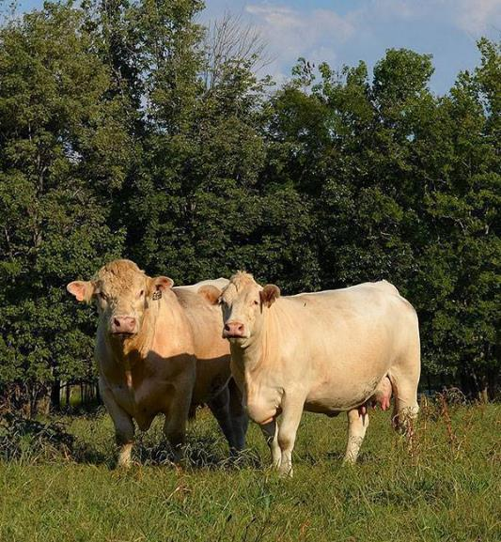
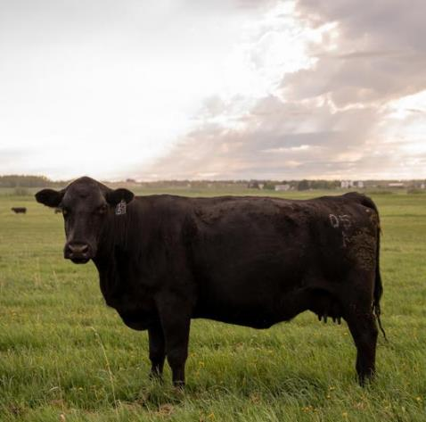

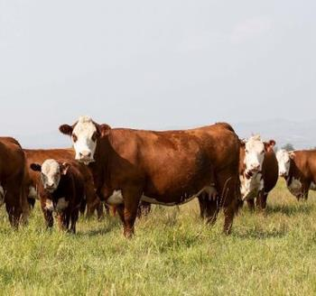
Source: Charlois Association
Source: Angus Association
Angus Breed
Source: Hereford Association
Charolais Breed
Hereford Breed
Cattle that are alike and have similar traits, like hair color or size, are called a breed.
Notes:
Some breeds have the genetics to grow larger than others. Some cattle have horns, but most do not (cattle without horns are called “polled”)

Slide 7

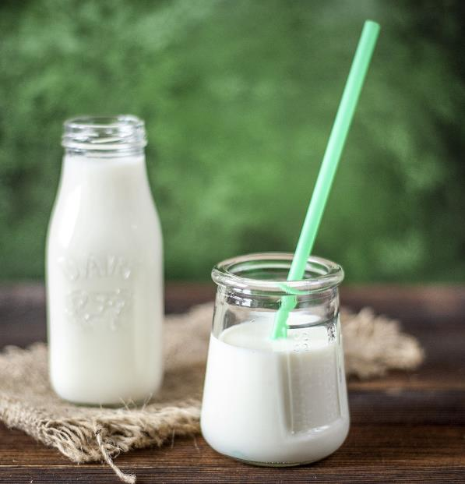
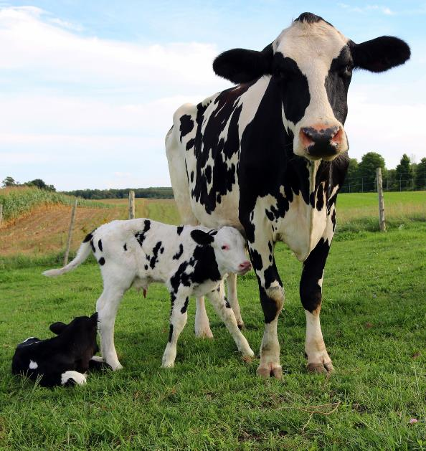
This cow is a Holstein,
a breed used to produce milk.
Notes:
Dairy cows have a different body shape than beef cows. They have a bigger udder to give milk. Dairy cattle are not just black and white. They have many colors, too.

Slide 8

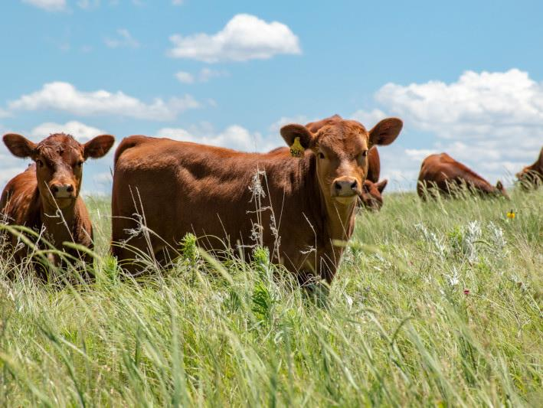
Cows are bred to have babies. This calf is a baby beef animal.
It weighs about 80 pounds when it is born.
Notes:
How many of you would it take to equal an 80 pound calf? The calf will try to walk soon after it is born so that it can eat. Their legs are very wobbly because they have never walked before.

Slide 9

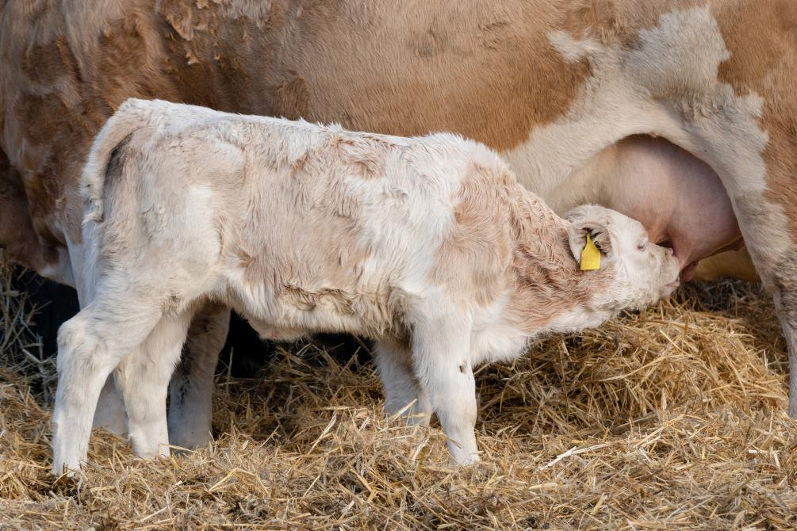
Calves nurse from their mother’s udder several
times a day.
The udder is part of the female cow that provides milk for the calf.
Notes:
Nursing is drinking milk from the cow’s udder. The udder is a part of the female body and provides healthy milk to its babies. A calf will nurse from its mother several times throughout the day and night.

Slide 10
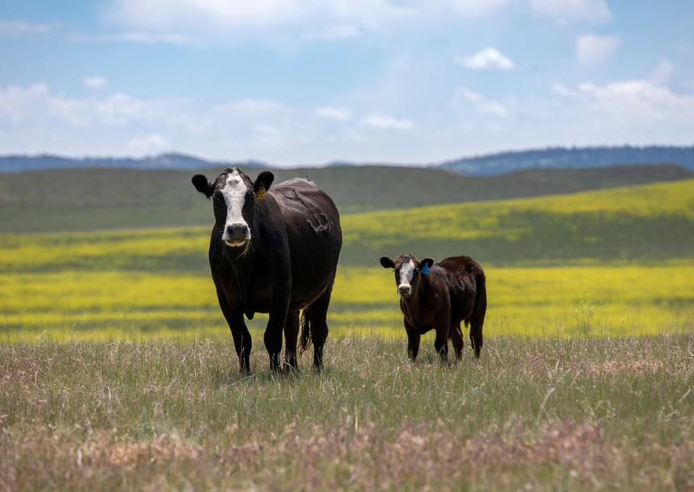

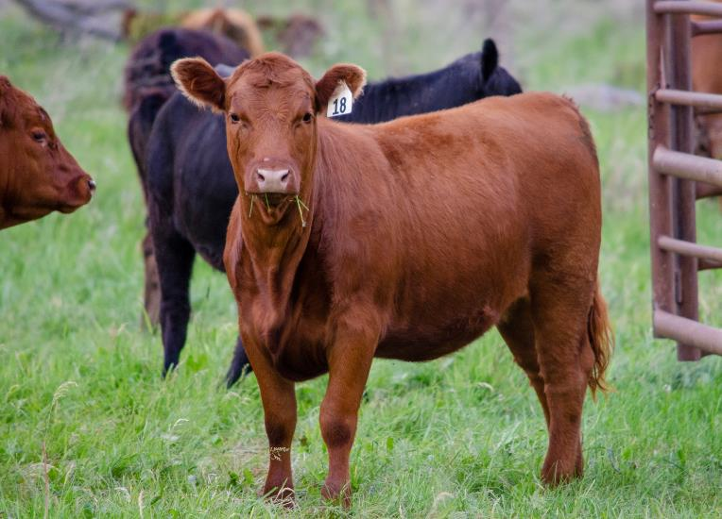

Cow ~ 2 years old
Calf ~ 2 months old
heifer ~ 1 year old
Heifers are young females that have not had babies. When heifers are bred to a bull, and have a calf, they are called a cow. It takes 9 months for a calf to be born.
Notes:
Heifers are young females with no babies; they are like teenagers. Cows are mothers. It takes 9 months for a calf to be born.

Slide 11


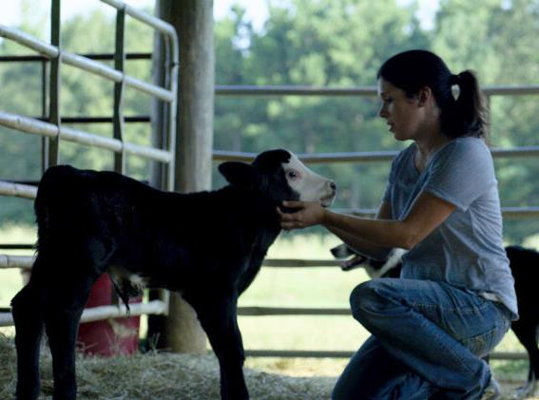
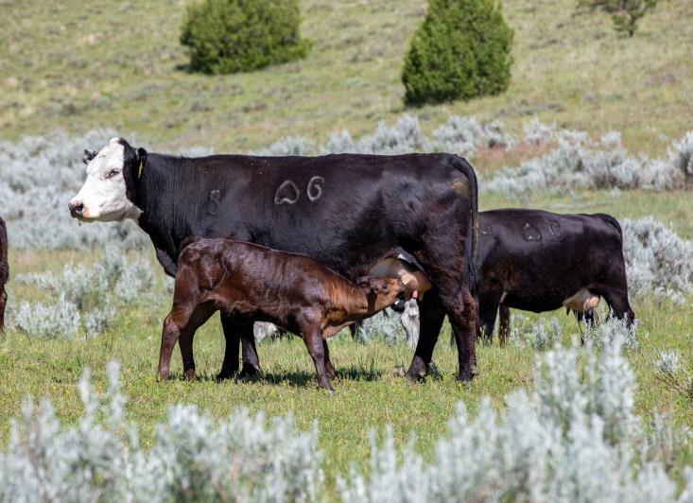
The calf will live with the cow until it is about six months old and weighs about 500 to 600 pounds. At this time, calves are big enough to live on their own, and farmers wean, or separate the calves from their mothers.
Notes:
By watching its mother, a calf learns to eat grass and hay and drink water. Weaning occurs when calves are eating on their own. Weaning separates the cow from her calf so the calf can eat more food and grow. The calf usually weighs between 500 –600 lbs at weaning.

Slide 12

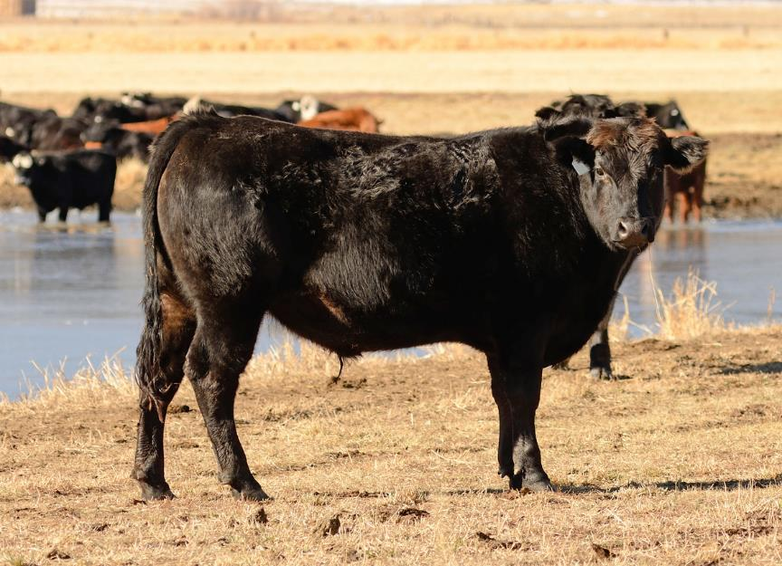
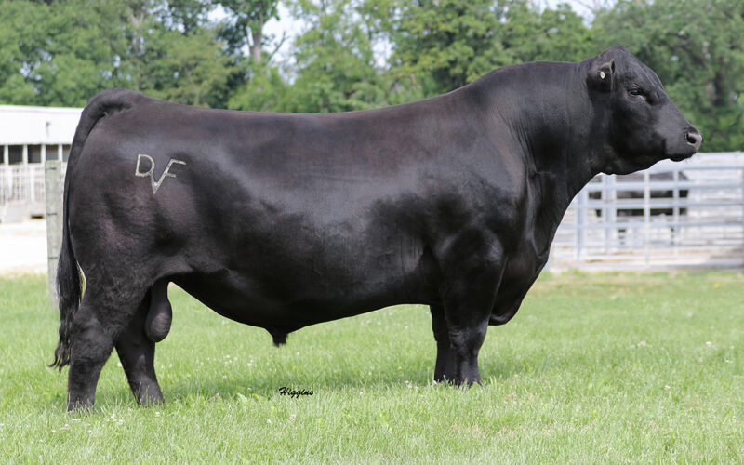

bull ~ 2 years old
steer ~ 1 year old
Bulls are males. Steers are males which are neutered, like pets, so they cannot reproduce.
Notes:
Bulls are fathers. Steers are young males who are growing but have been neutered so they cannot be fathers.

Slide 13
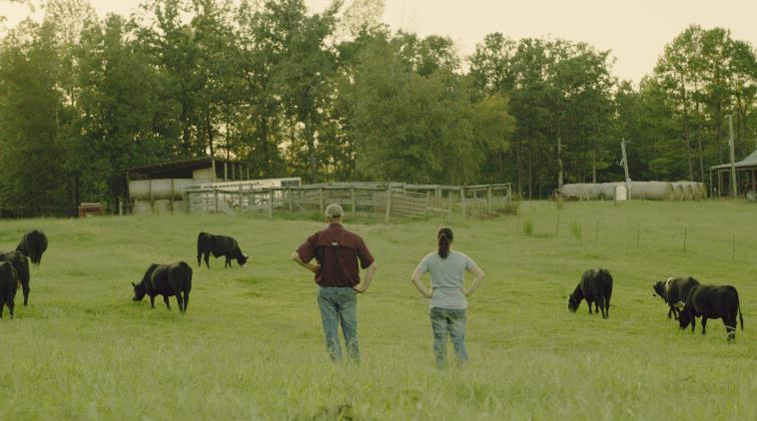
Farmers check their cattle every day to keep them healthy. They give them food, water, shelter, and check for illness.
Notes:
Cattle producers must be efficient to stay in business. This requires proper feeding, care, handling, and health maintenance – which sometimes means shots. It is important to take care of health problems when they occur so the sick animal does not make the rest of the herd sick, too. A herd is a group of cattle that are in the same pen or on the same farm. Animals get vaccinations to prevent them from getting sick, just like you did before starting Kindergarten.

Slide 14
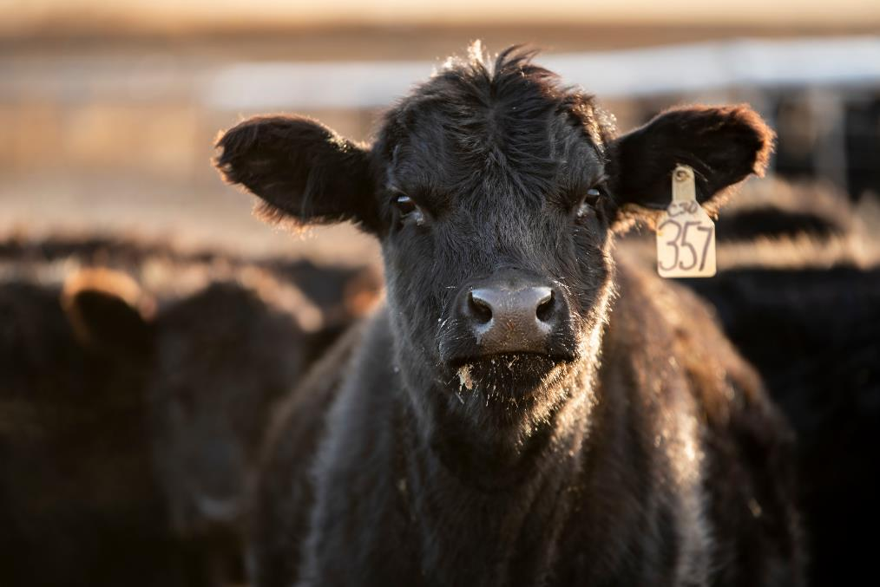


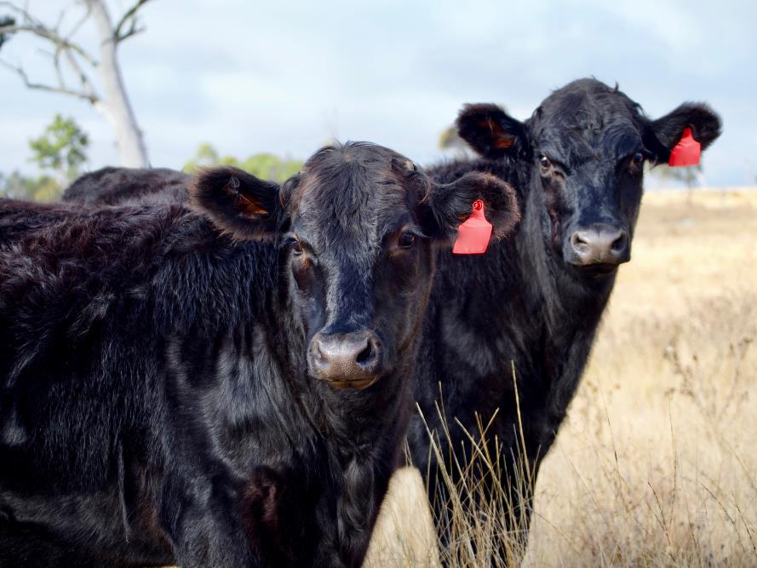

The farmer uses ear tags to identify every animal.

Slide 15
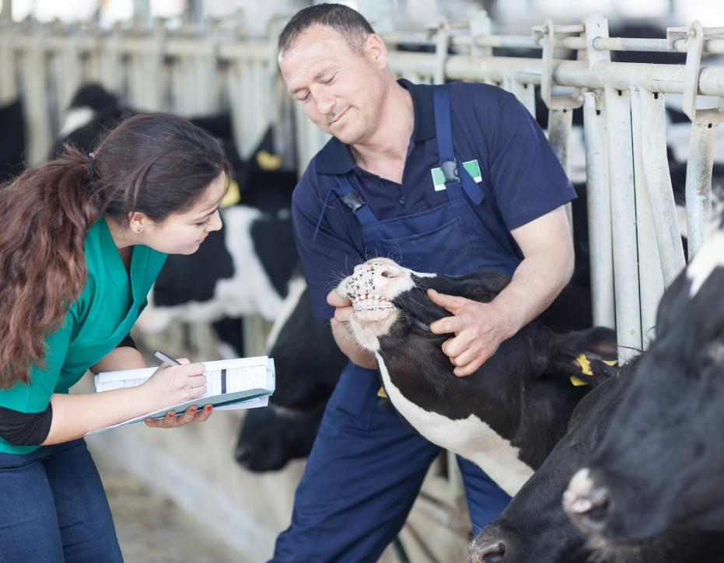
When animals get sick or injured, farmers call veterinarians to help make their cattle healthier. Cattle also get vaccinations to prevent illness just like humans do.
Notes:
Even with all of the things farmers do to care for animals, sometimes they get sick. Veterinarians are animal doctors who diagnose and treat diseases and injuries to animals.

Slide 16
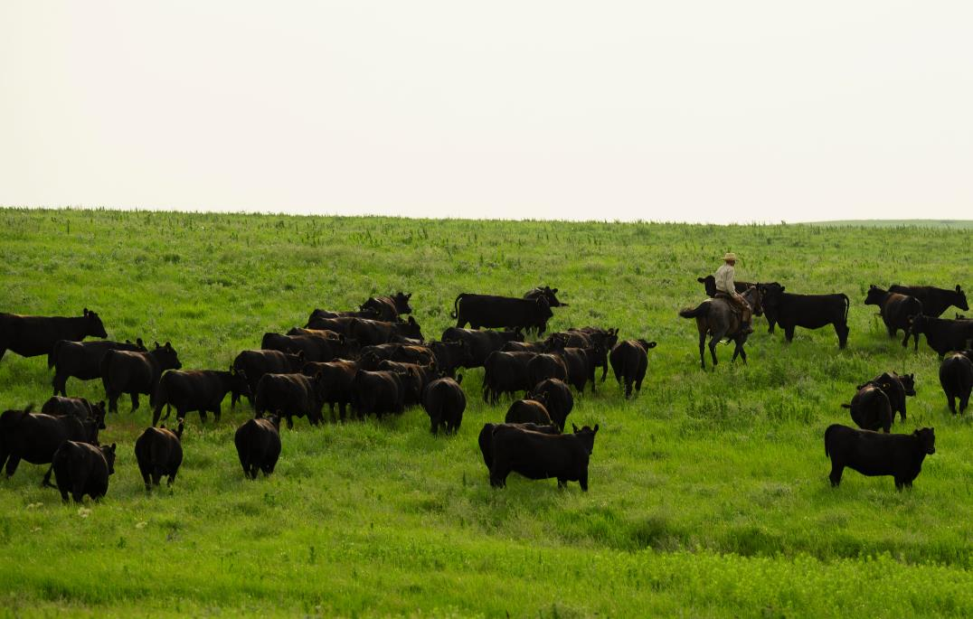

Cattle are very special animals that eat grass, hay and other plant products that people cannot eat. A pasture is a field of grass that is grown to feed animals.
Notes:
Pasture is grass in a field grown specifically for animal use. Cattle graze on land that can’t be used for other food production because it is too steep or hilly, or too dry or too rocky for growing crops. Animals are the perfect use for it! Cattle grazing helps keep the weeds from growing.

Slide 17
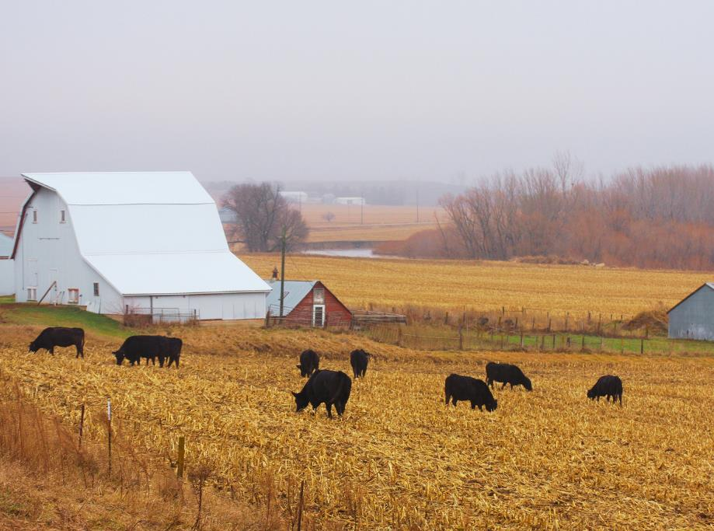
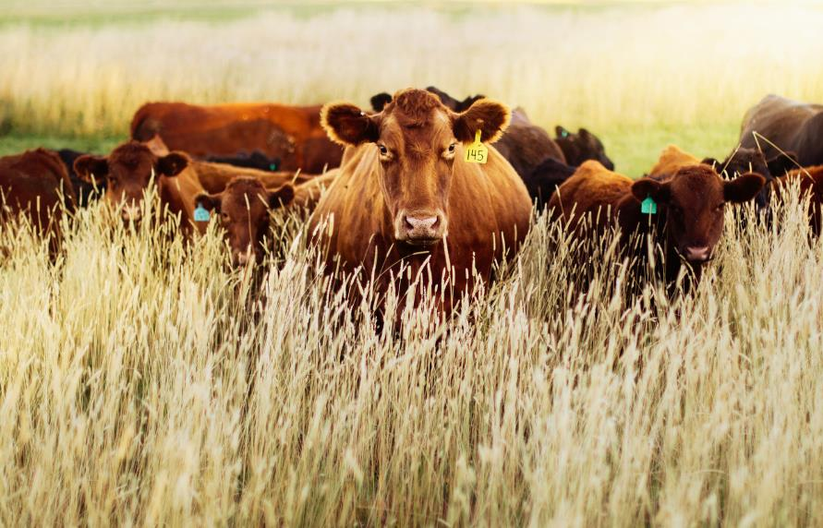
Humans cannot digest 85% of what cattle eat.
Half of the plant material resulting from food production would go to waste if cattle didn’t eat it.

Slide 18
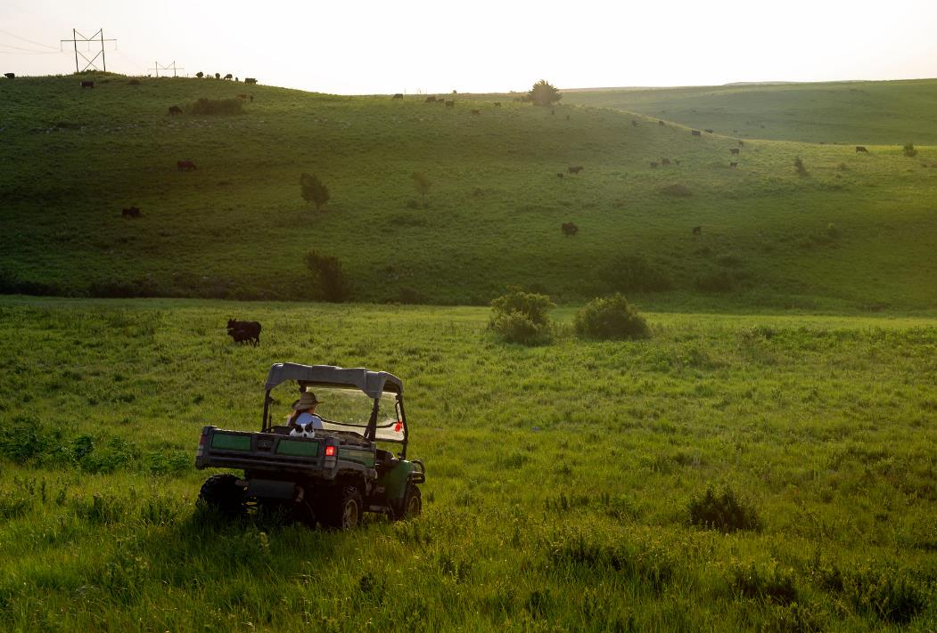
Some land is too hilly, rocky, steep, or dry for growing food crops. Keeping this land in grass or pasture helps prevent soil from washing away. Grass helps prevent soil erosion.
Notes:
When cattle are properly grazed, they benefit the land by loosening the soil when they walk on it. This allows more oxygen to enter the soil, helping grasses and plants grow better. Cattle also provide a natural fertilizer to the soil in the form of manure for the soil, its plants and grasses.

Slide 19
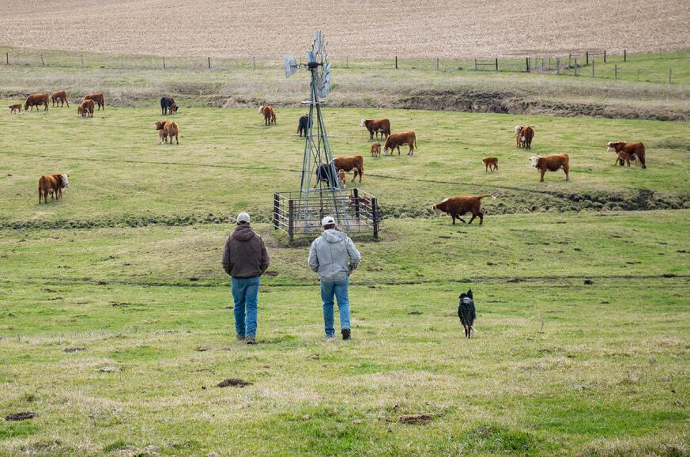


When cattle eat grass, it is called grazing. Cattle provide natural fertilizer for the land as they walk around and leave manure. Manure provides nutrients for the plants and grasses.
Notes:
About 1.2 billion acres of land in the US fall into grazing land – one half the size of the United States. At least 90% of those acres are covered with grass. Indigestible by humans, grass can by digested by cattle, which in turn becomes beef and dairy products.

Slide 20

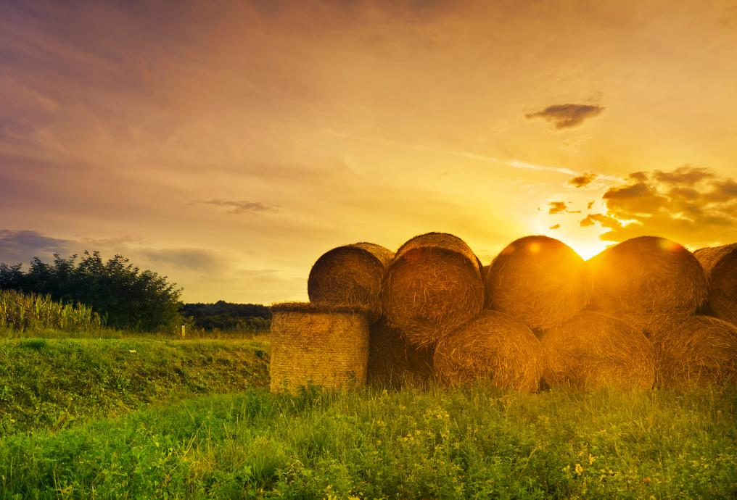
Farmers cut hay and grass, dry it, and put it in large bales. Cattle eat hay in the winter when grass doesn’t grow.
Notes:
How many of you have seen bales of hay in fields before? June, July and August is hay time on most cattle farms. Hay is long grass such as alfalfa that have been cut and dried to use as animal feed. Farmers cut the grass with a big mower and leave it to dry in the field for about two days. The dry hay is bundled into bales and stored in the barn. Round/Large bales weigh about one thousand pounds. A round/large bale is enough hay for a couple of days.

Slide 21
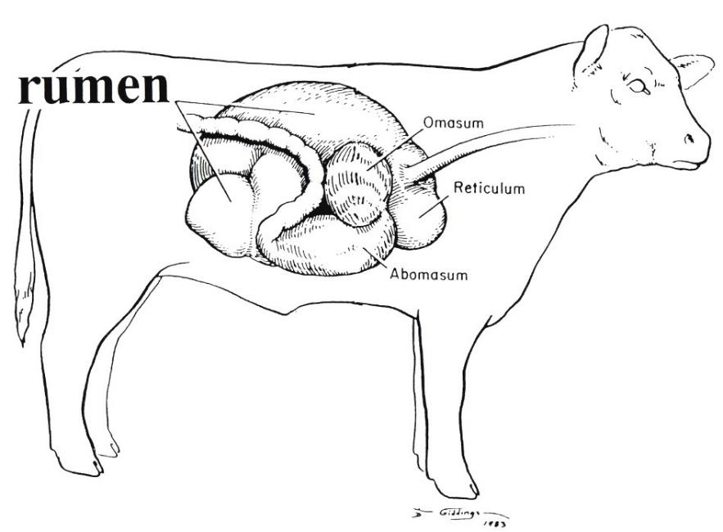
Cattle can eat grass and hay because they are ruminants, meaning their stomach has four parts. After eating, cattle chew their cud. Feed is brought back up from their stomach to chew.
Cattle spend one-third of their life eating, one-third ruminating (chewing cud) and one-third resting.
Notes:
The RUMEN is one part of the cow’s four part stomach. It can digest things like hay and grass that humans cannot. When cattle are in the pasture, sometimes it looks like they are chewing gum. Really, cattle are chewing their cud. This is regurgitated food that they continue to chew so that their special stomach can digest it. Chewing their food again helps them digest the grass and hay.

Slide 22
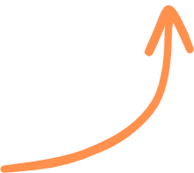
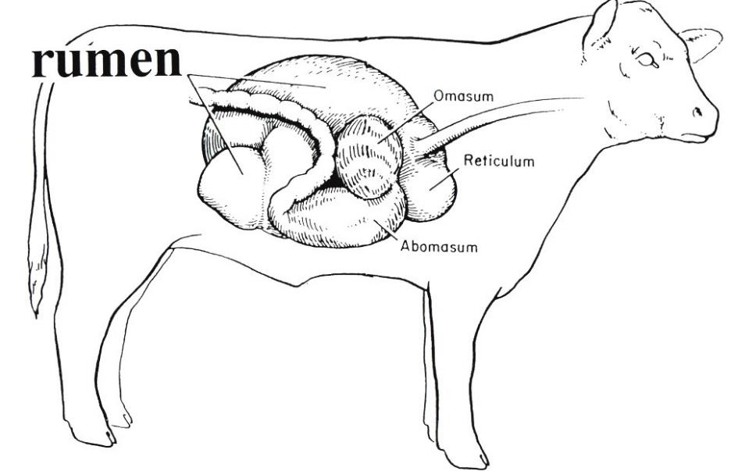


The rumen is the largest of the 4 parts of a cow’s stomach…it can hold 40 gallons!
Only ruminants, like beef cattle, turn otherwise unused tons of grass and roughage into protein.

Slide 23


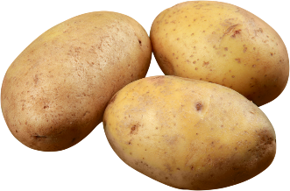
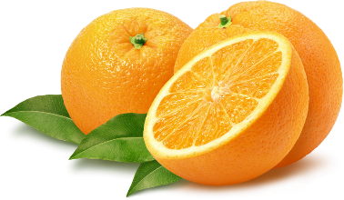
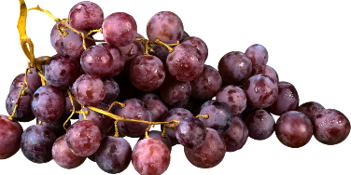
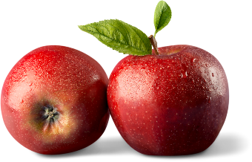
In parts of the United States, some cattle also
eat seeds and peels from:
potatoes
oranges
grapes
apples
Cattle are really recycling machine.
Because of their stomach, cattle can eat waste materials from food processing that otherwise might go to the landfill. They turn these products into meat for humans.
Notes:
Examples include corn gluten which is leftover from ethanol production, potato skins, fruit pits, almond hulls, and sugar beet pulp. This greatly reduces the amount of waste that goes into our landfills. They turn these products into protein (beef) for humans.

Slide 24

Sun & Soil
manure
rain
Natural
Recyclers
grass & hay
cattle
corn
The sun, soil, and rain help hay and grains grow. Cattle eat renewable resources like grass and turn them into meat, milk, and other products for humans. Waste from cattle (manure) is applied back to the soil to give the soil nutrients to grow plants.
Notes:
The sun, soil, and rain help or are natural resources for hay and grains grow. Cattle eat renewable resources like grass and turn them into meat, milk, and other products for humans. Waste from cattle (manure) is applied back to the soil to give the soil nutrients to grow plants.

Slide 25
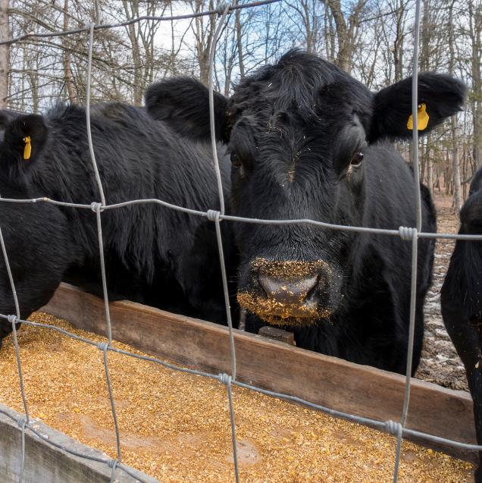

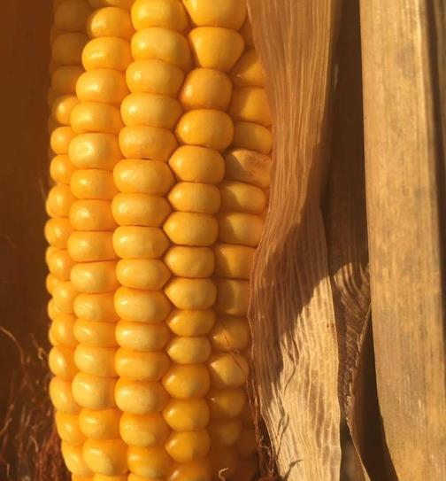
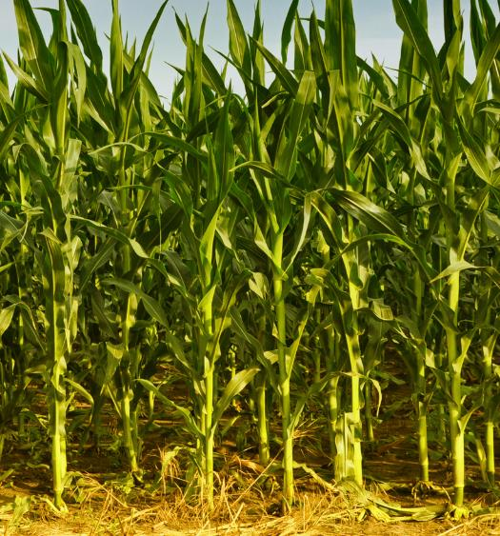
Iowa farmers raise more corn than any other state.
Much of the corn is used to feed livestock.
This corn is field corn, not the sweet corn that we eat.
Notes:
Livestock is a term used for farm animals such as cattle, sheep, hogs, horses, etc. After calves are weaned, they go to a feedlot to eat more and grow bigger. Have any of you seen corn growing in the fields along the road? That corn is grown to feed animals, like cattle. It is harvested by the combine and then ground up for cattle to eat as grain. The corn that cattle eat is not like the sweetcorn that humans eat.

Slide 26
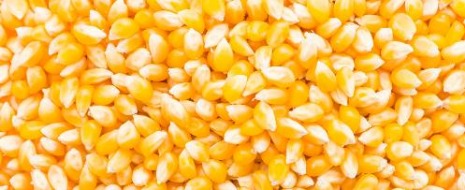

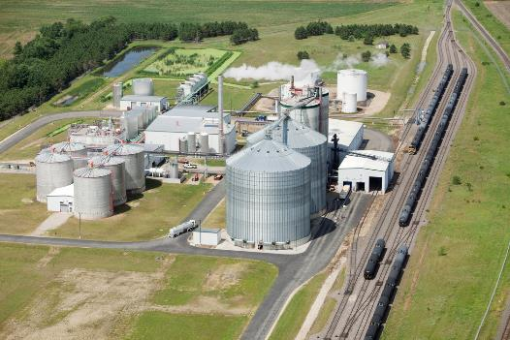
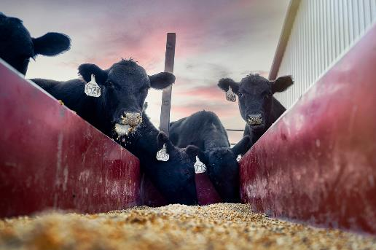
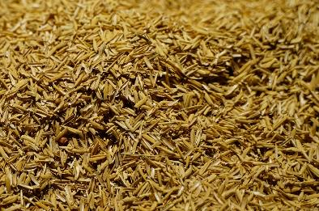
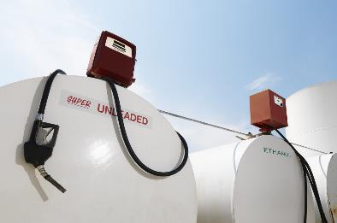
Ethanol and Cattle Cycle
Ethanol plants produce ethanol leaving distillers grains as a co-product
The cattle fertilize cornfields with manure, resulting in higher corn yields.
Distillers grains can be fed to livestock, especially cattle.
Notes:
Co-products are produced during the process of getting another product. Ethanol is the product in focus, but distillers grains are produced in the process, and have been found to be a very cheap feed source for livestock.

Slide 27
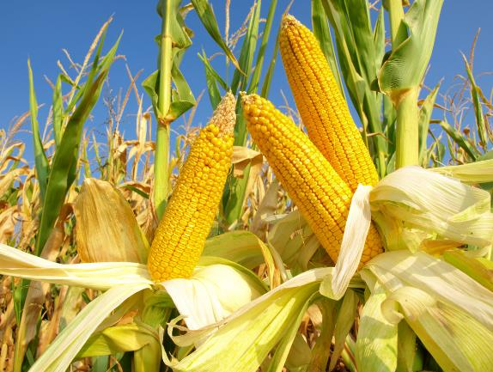
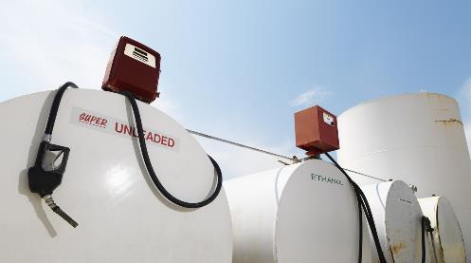

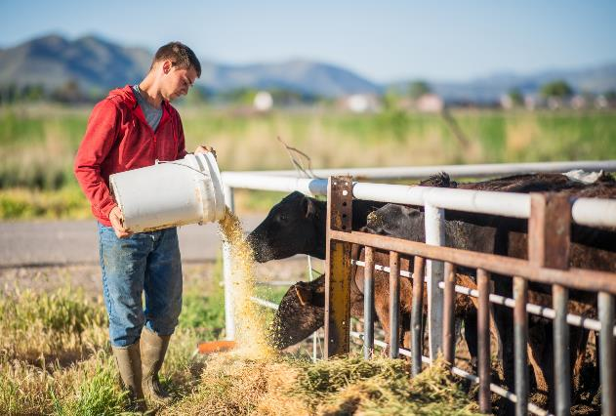
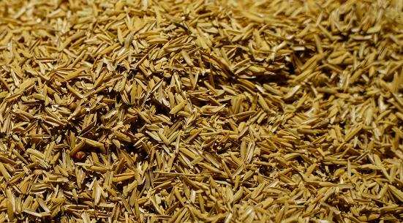
We need livestock to eat what’s leftover from ethanol production.
2.7 gallons
of ethanol
Cattle get protein, fiber, and vitamins from distillers grains.
1 bushel of corn
= 56 pounds
17 pounds of
distillers grains
Cattle really like the taste!
Notes:
Cattle receive large amounts of protein, fiber, and vitamins from distillers grains(DG). DGs have a very sweet taste, so cattle love it.

Slide 28
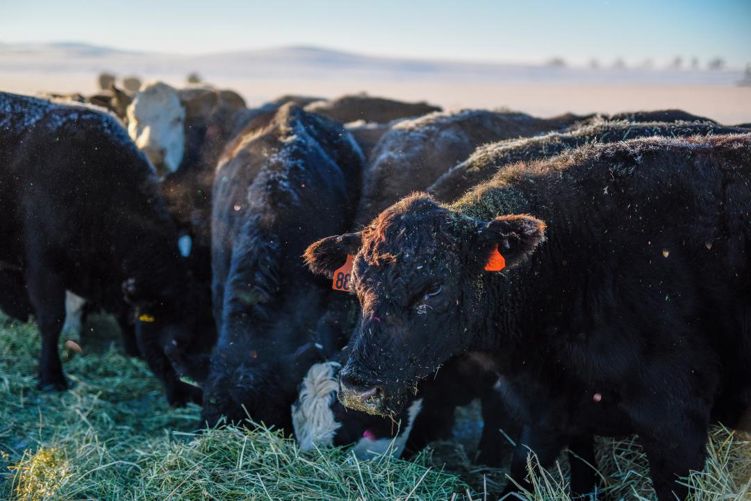

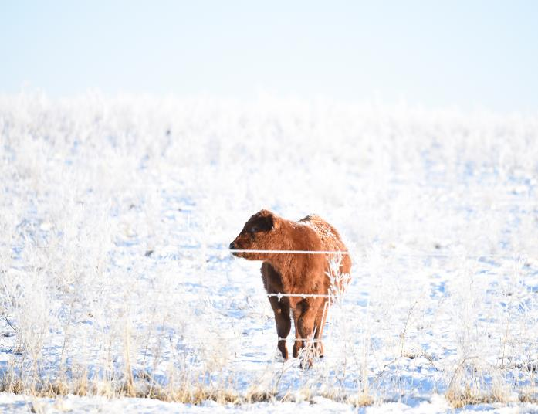


BRRR!
Cattle can live outside all year long. Their hair grows thicker and longer in the winter to keep them warm.
Notes:
Cattle have a special coat of hair that protects them all year long. In the winter, their hair grows longer and is thicker to protect them from the cold temperatures and snow. And in the summer, their hair keeps them cool from the sun and warm temperatures. It is important for cattle to have protection from some of the weather elements. That is why there are trees, windbreaks and barns for the cattle to protect them from snow, wind, rain, and the sun.

Slide 29


A feedlot is where beef cattle finish growing. The pens are open, with lots of space and dry resting areas. There is housing behind the cattle for protection from the weather. Cattle eat mostly corn and hay in the feedlot.
Notes:
In feedlots, cattle are generally placed in open pens, with lots of space, dry resting areas, adequate water at all times and feed regularly. There is shelter behind the cattle for protection from the weather. Cattle eat hay and grain.

Slide 30





Steers and heifers are ready for market when they weigh about 1350 pounds. It takes about 1 ½ years from birth to produce an animal ready for market.
Notes:
How much do you weigh? How many students does it take to weigh 1350 pounds? Gestation of a cow takes nine months; an additional 16-18 months is needed for animal to be ready for market.

Slide 31


Source: On Pasture
Source: Oxford Salebar
Farmers may sell their cattle at an auction market where
cattle buyers bid on cattle in the ring.
The auctioneer sells the cattle. A cattle buyer may come directly to the farm to buy cattle from the farmer.

Slide 32

Cattle travel by truck to a harvesting facility where they become beef. Cattle are raised to provide food for people.
Notes:
Remember, cattle are not pets. Cattle are harvested at the harvesting facility. They are quickly killed by humane methods.

Slide 33



Meat inspectors employed by the government carefully inspect the cattle, beef, and harvesting facility to be sure the beef is safe. Workers cut up the beef and package it to sell.
Notes:
The United States Department of Agriculture inspects all meat harvesting facilities to be sure the beef is safe and the plant is clean. The beef carcass is divided into portions of beef.

Slide 34






The beef is sold to supermarkets, restaurants, schools, hospitals and other places. Some of Iowa’s beef is sold to other countries.

Slide 35






Many of our favorite foods are made with beef. Cattle give us roast beef, hamburger pizza, sloppy joes, steak, tacos, meatballs for spaghetti, and many more foods!
Notes:
What are your favorite ways to eat beef?
*Hamburgers/Cheeseburgers, Pizza, Steaks, Tacos, Stir-fry, Roasts, Meatballs, Chili, Pasta/Lasagna, MANY, MANY MORE!

Slide 36



Besides tasting good, beef is a healthy food from the meat group of the food guide pyramid. Beef gives us protein, vitamins and minerals to help grow strong and have energy.
We say beef gives you ZIP!
Z
I
P
B
inc + ron + rotein and -Vitamins
Notes:
Eating right plays an important role in keeping you healthy and active. Beef has Zinc, Iron and Protein and Vitamin B which are important vitamins and minerals to keep you strong! We like to think of beef as a great tasting multi-vitamin.

Slide 37
But Wait!!
What else do we get from cattle
besides beef and milk?

Slide 38





Beef Animal
Meat Cuts
By-products
Cattle also provide us with many other
by-products which are parts of the cow that are used to make products for home, health, food and industry.
Notes:
Byproducts are value-added products other than beef that come from cattle. They are of considerably less value than the primary product, which is beef. Cosmetics, Sandpaper, Film, Buttons, Leather, Violin Strings; Medicines for: Insulin and Cholesterol. And MANY, MANY MORE products!

Slide 39







Cattle bones, hooves, blood and glands are used to make many products we use everyday.
Some examples are:
Glue
Crayons
Piano keys
Medicine
soap
Pet food
Notes:
Candy, Jell-O, Marshmallows, Soap, Crayons, Piano Keys, Glue, Baseballs and Gloves, Footballs, Soccer Balls

Slide 40







Gummy Bears
Marshmellows
Gelatin is made from cattle bones that are crushed and cooked. There is a gelatin plant near Sioux City, Iowa. Gelatin is used in many products we use each day.
Yogurt
Jello
Chewing Gum
Ice Cream

Slide 41









The hide of cattle is made into leather which is used to make clothing, shoes, sporting goods, gloves, and furniture.
couch
baseball
glove
gloves
shoes
briefcase
balls
bags
belt

Slide 42







Tires
Shaving Cream
Fat from cattle is made into fatty acids which are used in the manufacture of many products. Many cosmetics like lipstick and shampoo are made with fatty acids.
Lipstick
Shampoo
Charcoal
Paint

Slide 43




Next time you see cows grazing in a pasture, stop and think about all the amazing things they give us…
especially the cheeseburgers and steak!
Notes:
Review key concepts:
Why do farmers raise cattle?
What do cattle eat?
Where do cattle live?
How do farmers care for cattle?
What kinds of food do we get from beef cattle?
What by-products do we get from cattle?

Slide 44

Brought to you by the
Iowa Beef Industry Council
Representing Iowa’s beef producers with
funding from the beef checkoff.
For more information:
www.iabeef.org
www.beefitswhatsfordinner.com

