Slide 1

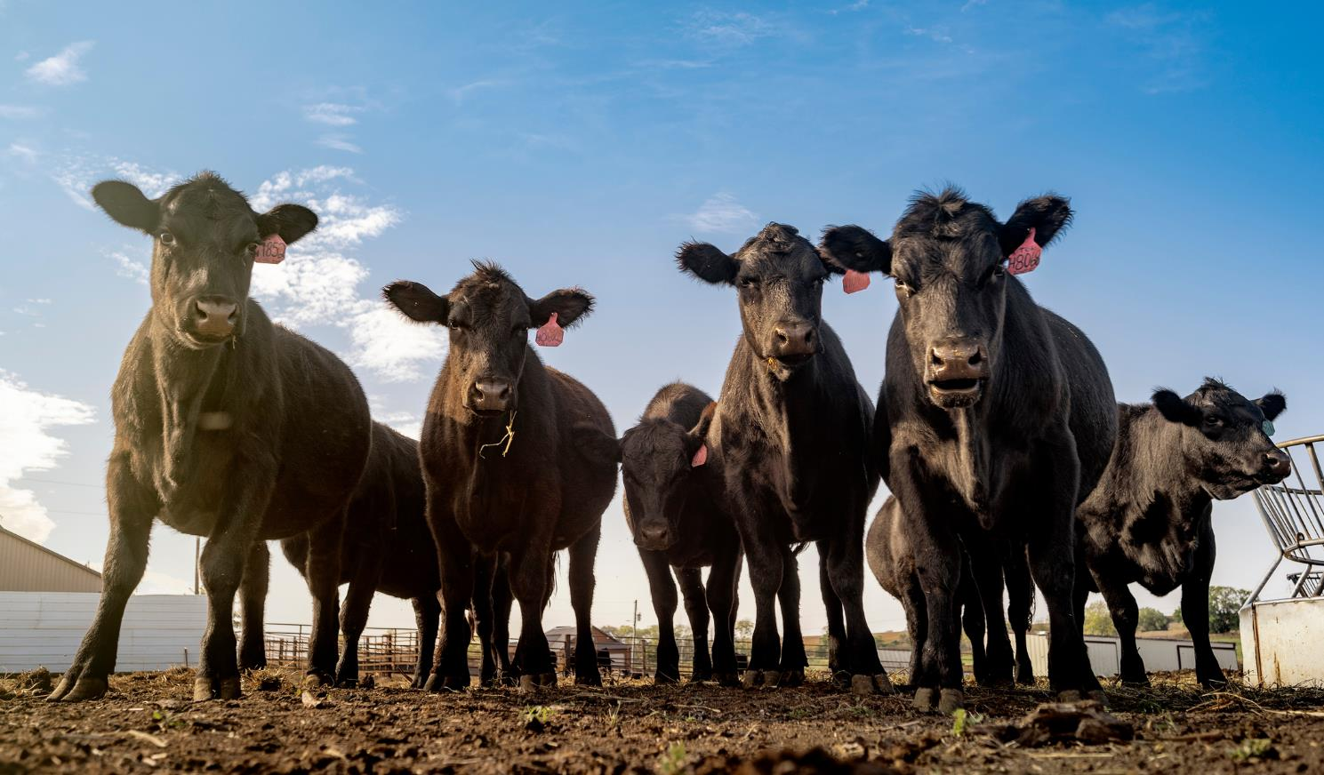

WOW THAT COW!
What cattle do for our lives and world.

Slide 2
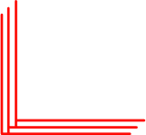
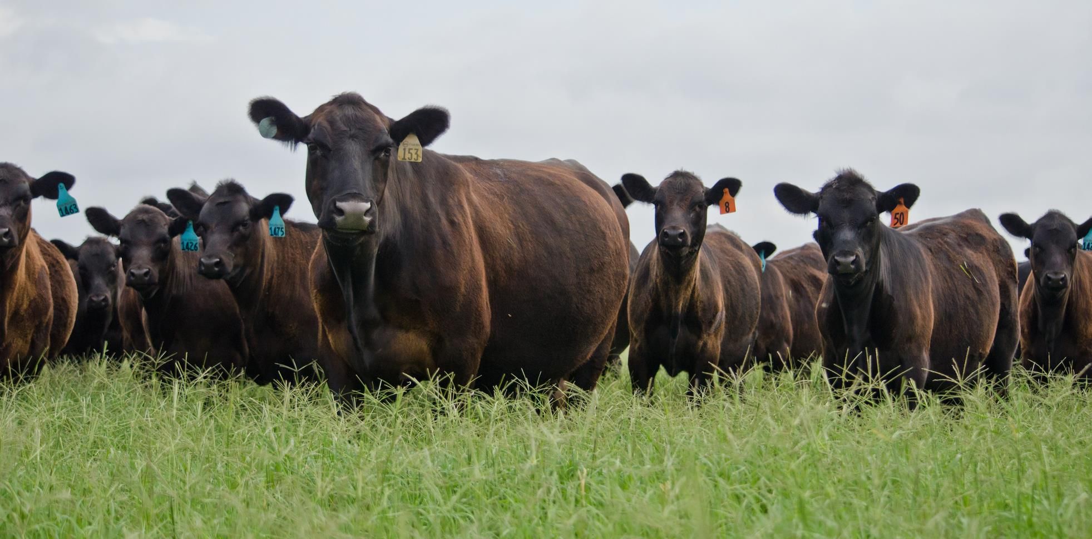
WOW! Cows live on Iowa farms.

Slide 3

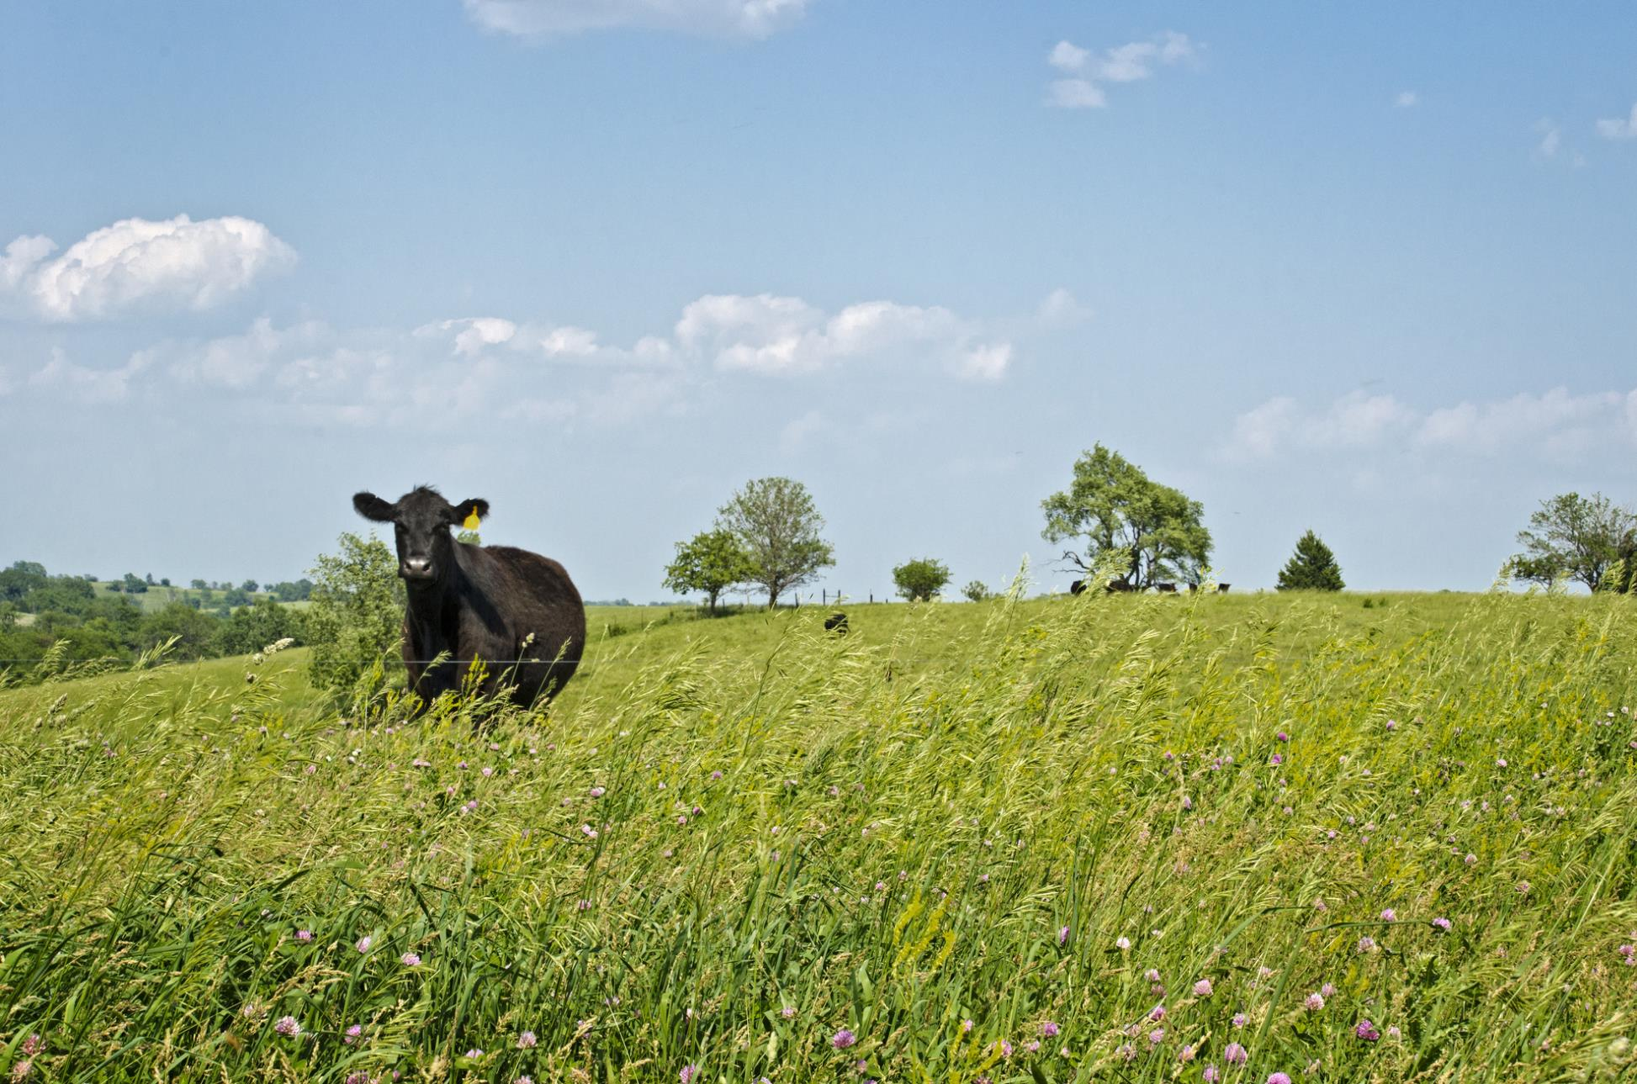
This is a beef cow. They give us meat.

Slide 4

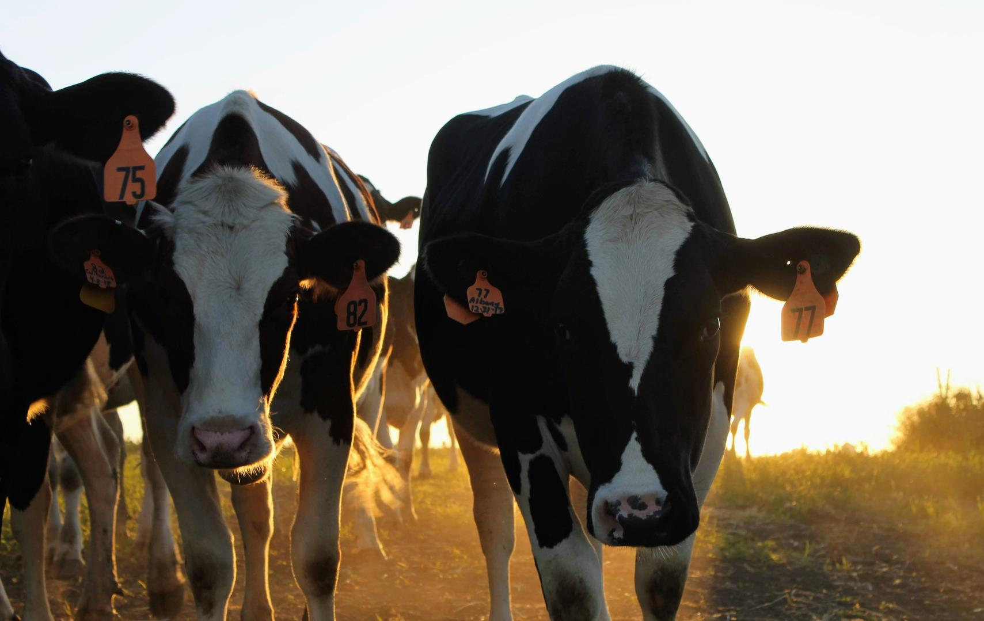
These are dairy cows, they give us milk.
Their breed is Holstein.
Notes:
Beef and Dairy animals are often confused. They can look similar, but Beef cattle are raised to provide meat for humans. Dairy cattle primarily provide milk, they also provide meat, too. They are both important, however, the animals are very different.

Slide 5

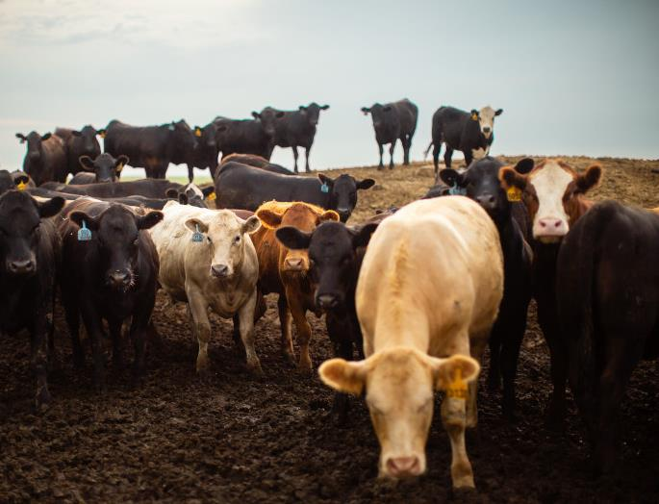
Just like people, cows come in different colors, shapes and sizes. Different kinds of cattle are called breeds. Cattle is a word used to describe two or more cows.
Notes:
Breeds are cattle of the same background and have similar characteristics, like color. There are over 70 different breeds of cattle. There are red ones, yellow ones, black, gray. Some have horns, but most do not. Cattle are not just black and white spotted. That is one type, but there are hundreds of different ways cows can look. A good comparison to cattle is people. People is a generic term for humans of different genders and sexes.

Slide 6

Dairy Foods
Beef Foods
Milk
Hamburgers
Hamburgers
Cheese
Cheese
Meatballs
Ice Cream
Ice Cream
Steak
Dairy cows give us foods made with milk.
Beef cows give us foods made with beef.
What are other milk and beef foods?

Slide 7

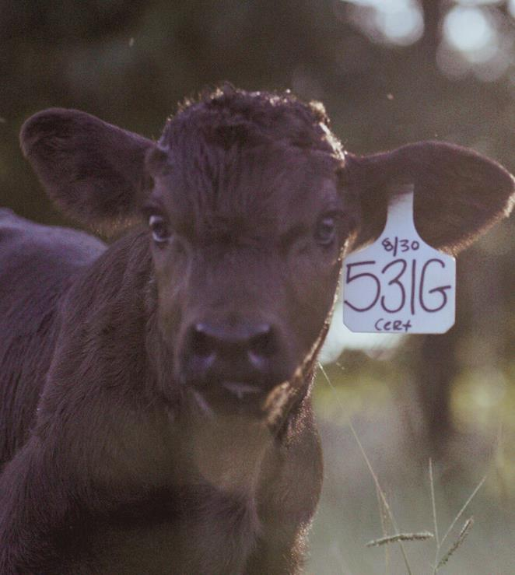
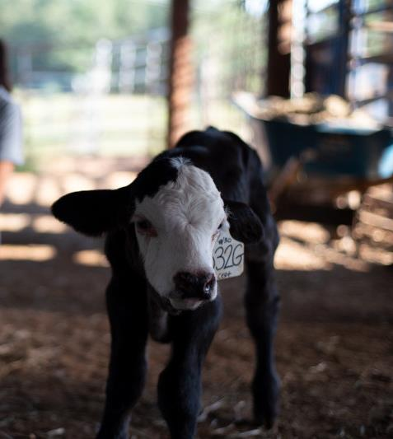
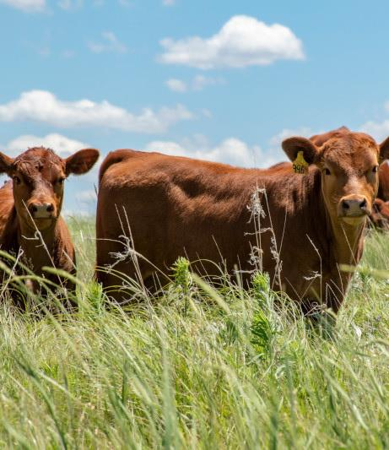
A calf is a baby cow. It weighs about 80 pounds when born. That is about the size of a 4th grader!
Notes:
How many of you would it take to equal an 80 pound calf? The calf will try to walk soon after it is born so that it can eat. Their legs are very wobbly because they have never walked before.

Slide 8
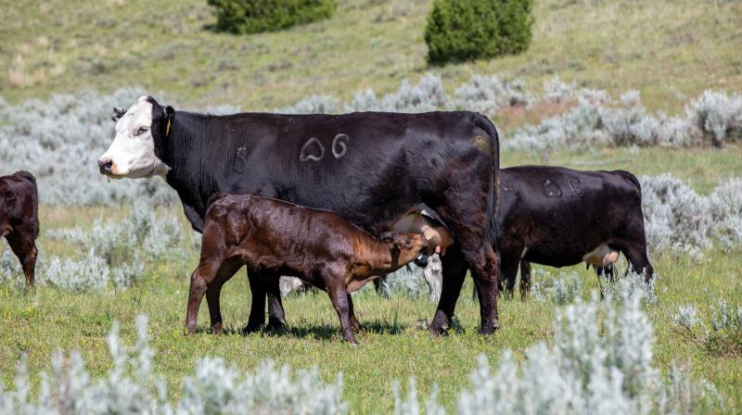
Newborn calves get milk, or nurse from their mother, a cow.
Notes:
Nursing is drinking milk from the cow’s udder. The udder is a part of the female body and provides healthy milk to its babies. A calf will nurse from its mother several times throughout the day and night.

Slide 9
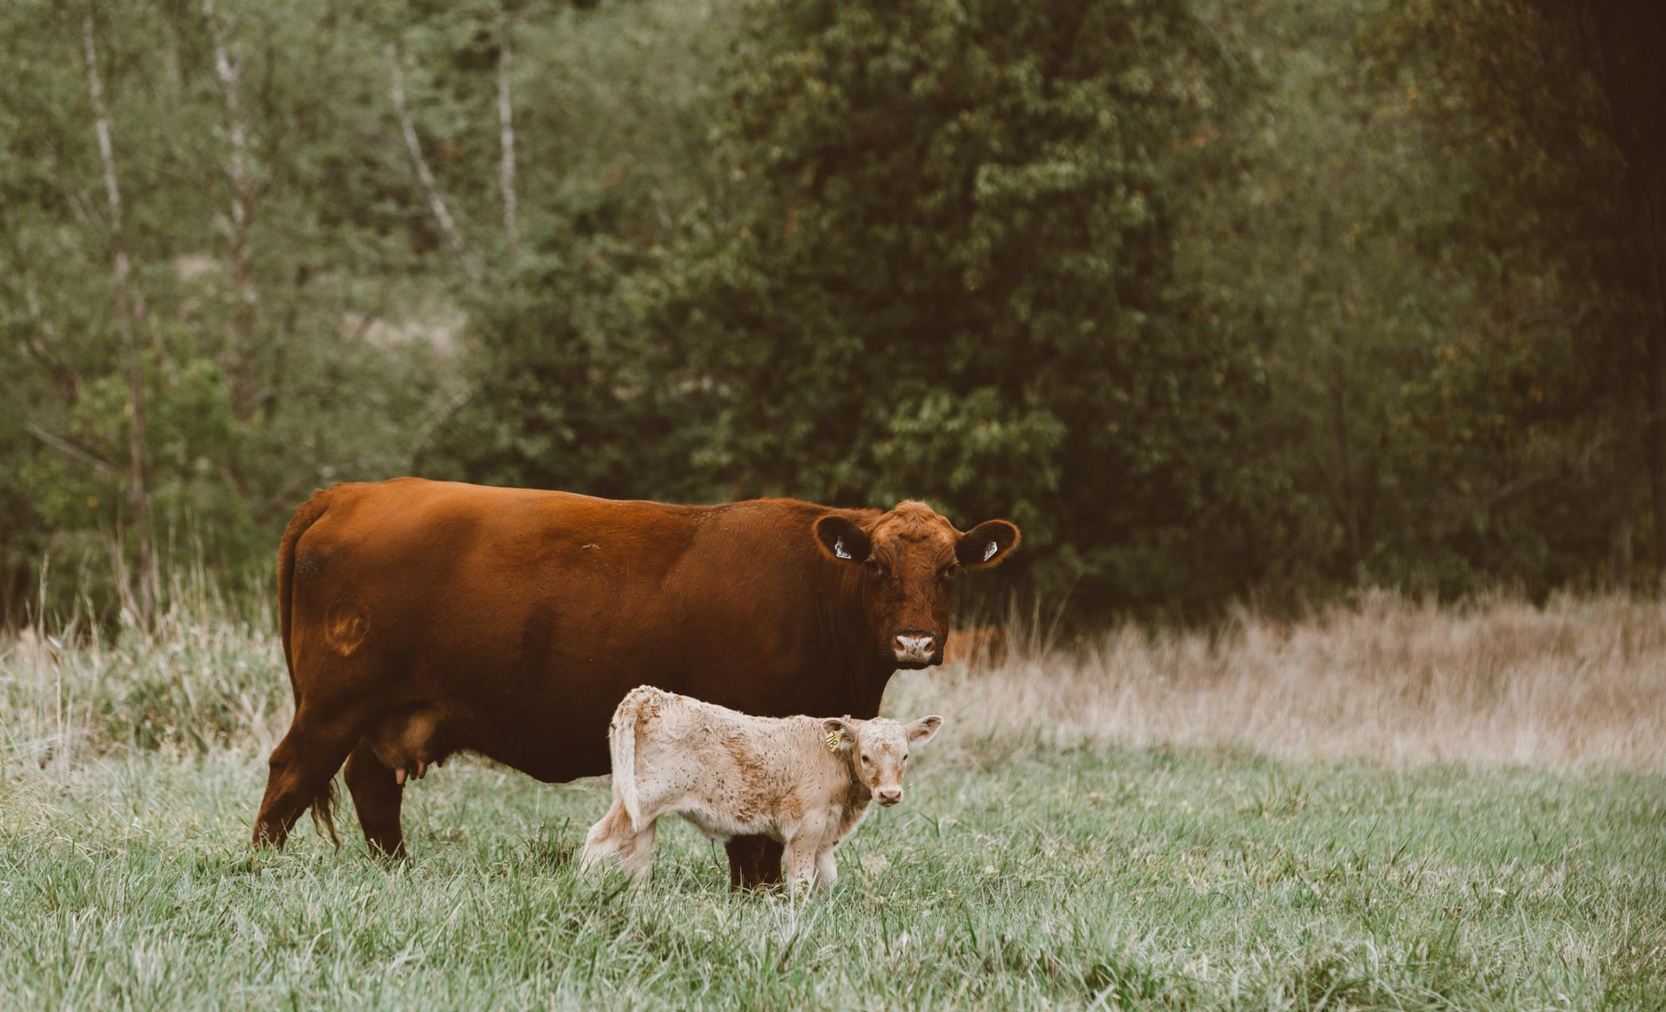
Girl calves are heifers.
They will become mother cows and have babies.
Notes:
Heifers are young females with no babies; they are like teenagers. Cows are mothers.

Slide 10
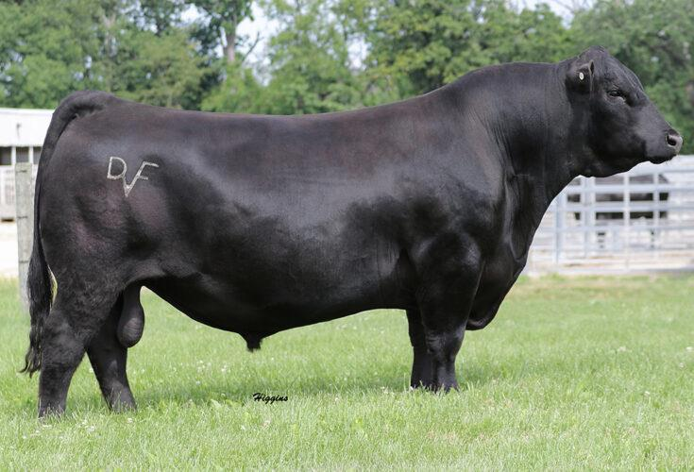

Bulls are the fathers of the calves.
WOW! Bulls
are big!
Notes:
Bulls are fathers. Steers are young males who are growing. Steers are neutered, like pets, so they can not grow to be bulls and reproduce.

Slide 11

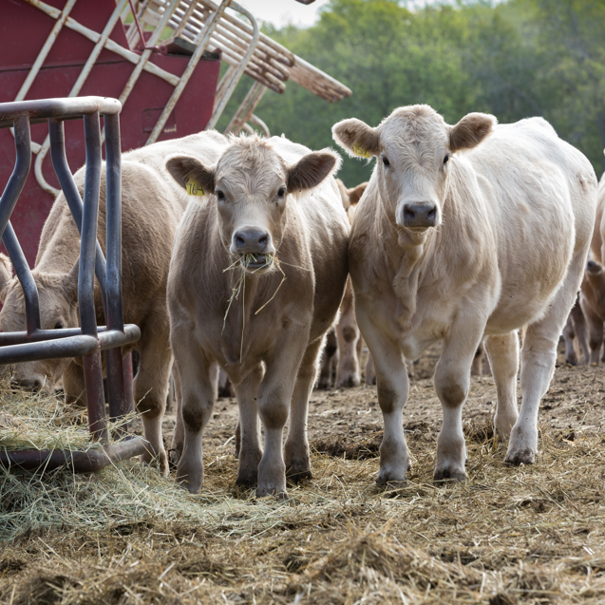
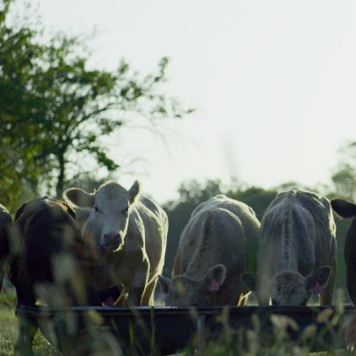
The calf will live with the cow until it is about six months old and weighs 500 to 600 pounds.
At this time, calves are big enough
to live on their own, and the farmers wean, or separate the calves
from their mothers.
Notes:
By watching its mother, a calf learns to eat grass and hay and drink water. Weaning occurs when calves are eating on their own. Weaning separates the cow from her calf so the calf can eat more food and grow. The calf usually weighs between 500 –600 lbs at weaning.

Slide 12
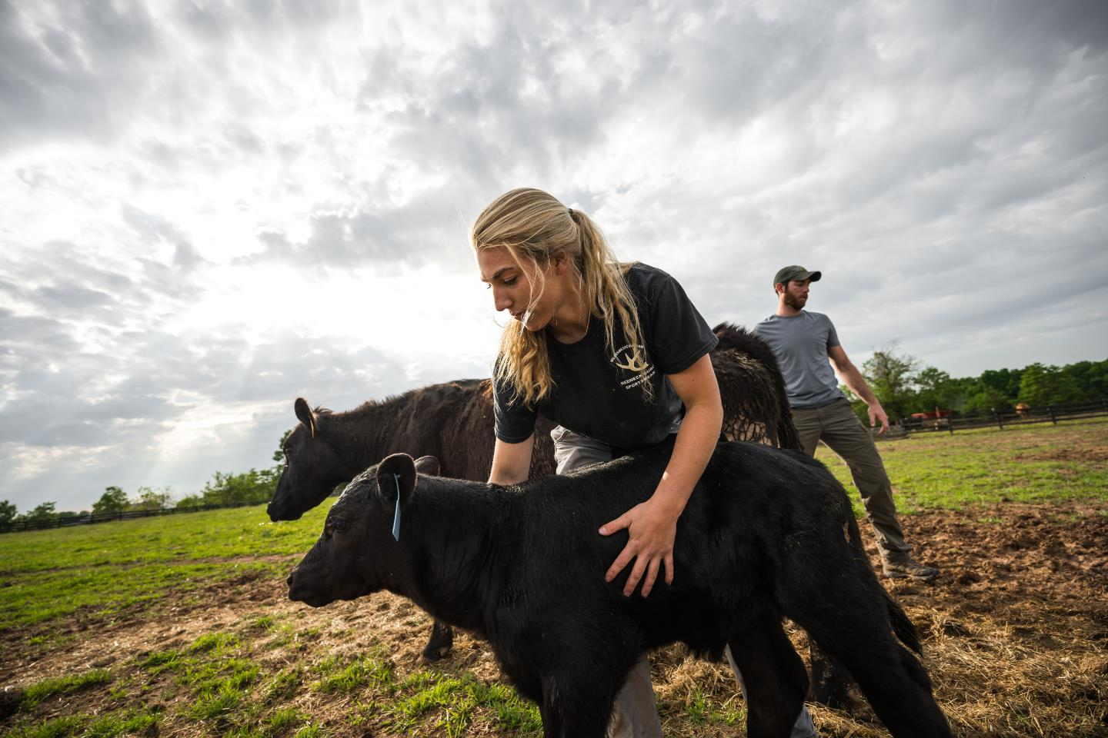

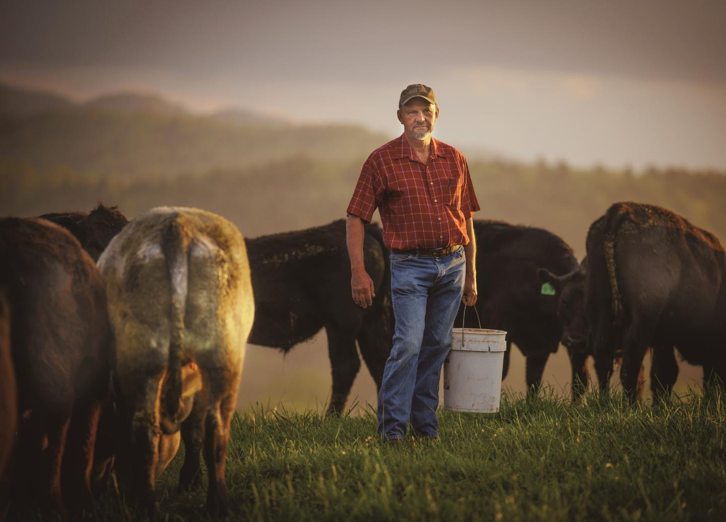
Farmers care for their cattle.
They give them food, water, shelter,
and keep them healthy.
Notes:
Cattle producers must be efficient to stay in business. This requires proper feeding, care, handling, and health maintenance – which sometimes means shots. It is important to take care of health problems when they occur so the sick animal does not make the rest of the herd sick, too. A herd is a group of cattle that are in the same pen or on the same farm. Animals get vaccinations to prevent them from getting sick, just like you did before starting Kindergarten.

Slide 13

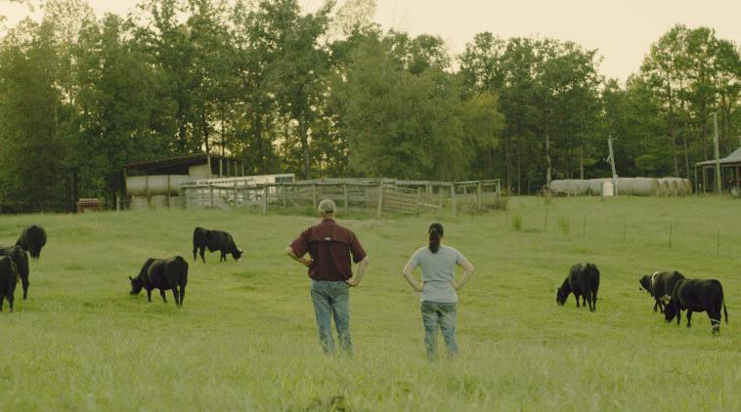

Farmers check their cattle everyday to make sure the animals are eating and drinking.

Slide 14
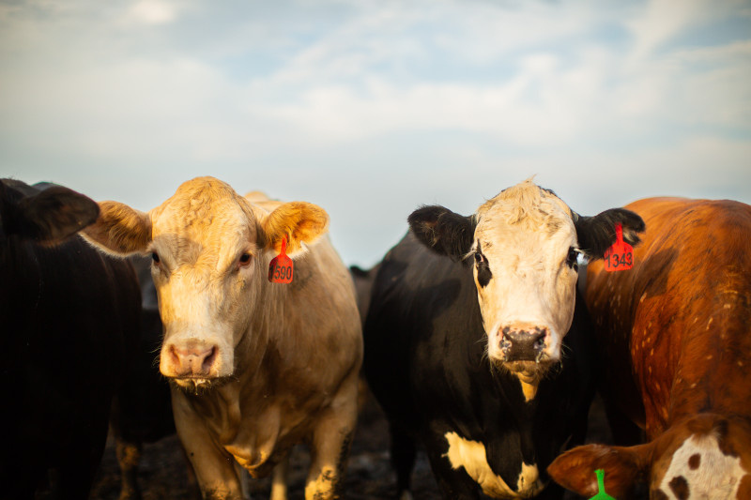

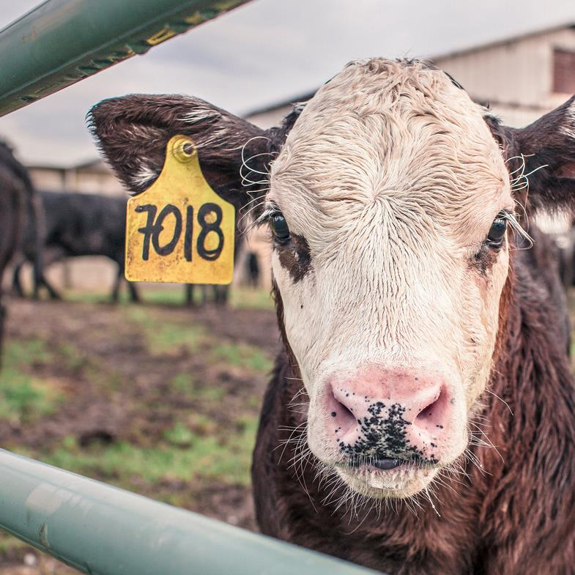
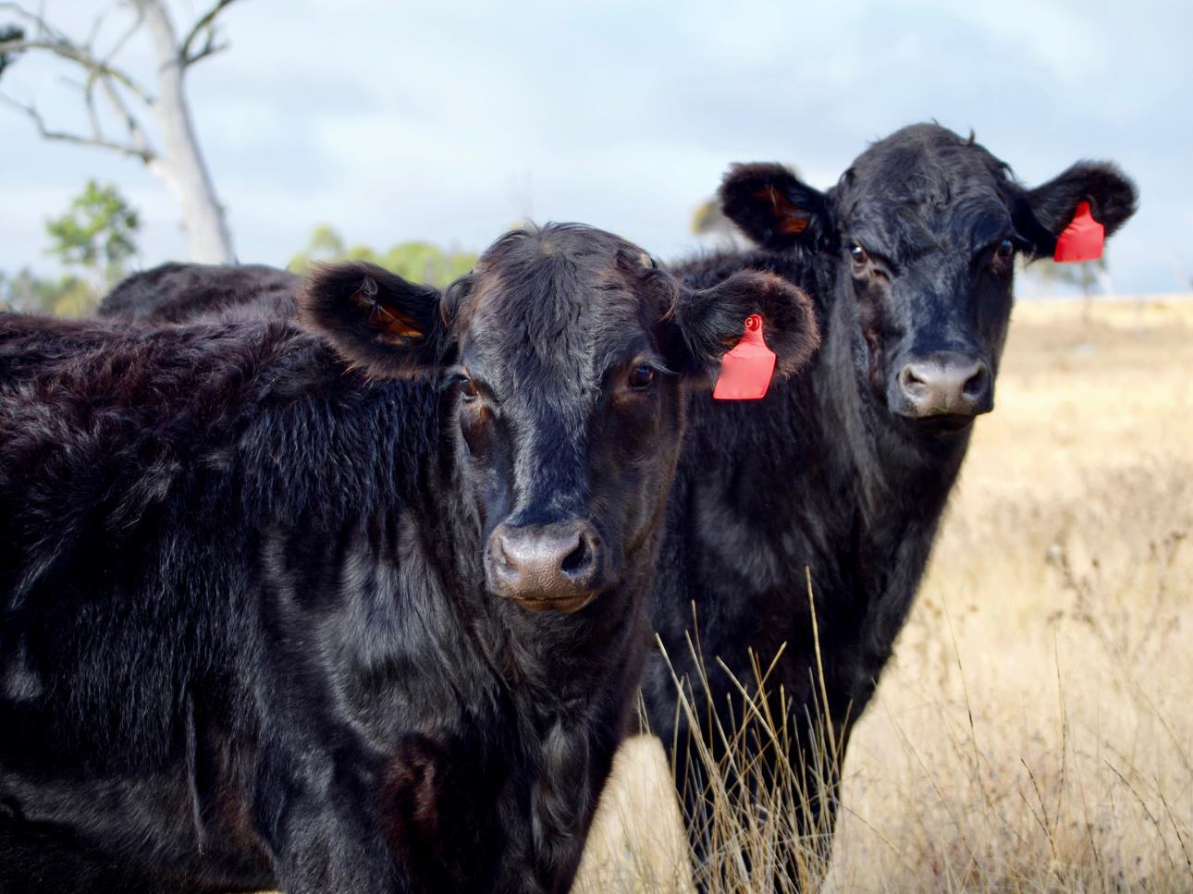
The farmer uses ear tags to know each animal.
Tags can be any color and can have numbers or names on them.

Slide 15
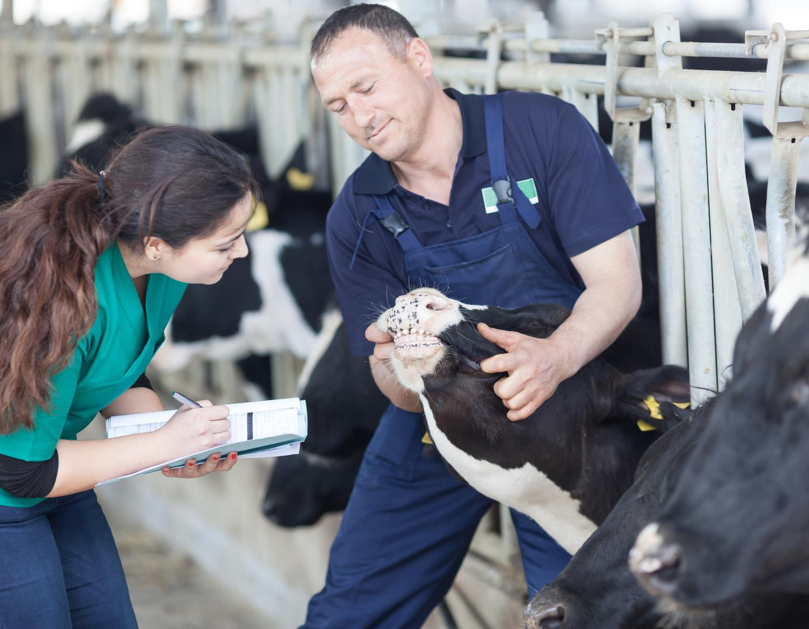
When animals get sick, farmers call animal doctors, who are called veterinarians, to help improve the health of their cattle.
Notes:
Even with all of the things farmers do to care for animals, sometimes they get sick. Veterinarians are people who diagnose and treat diseases and injuries to animals.

Slide 16
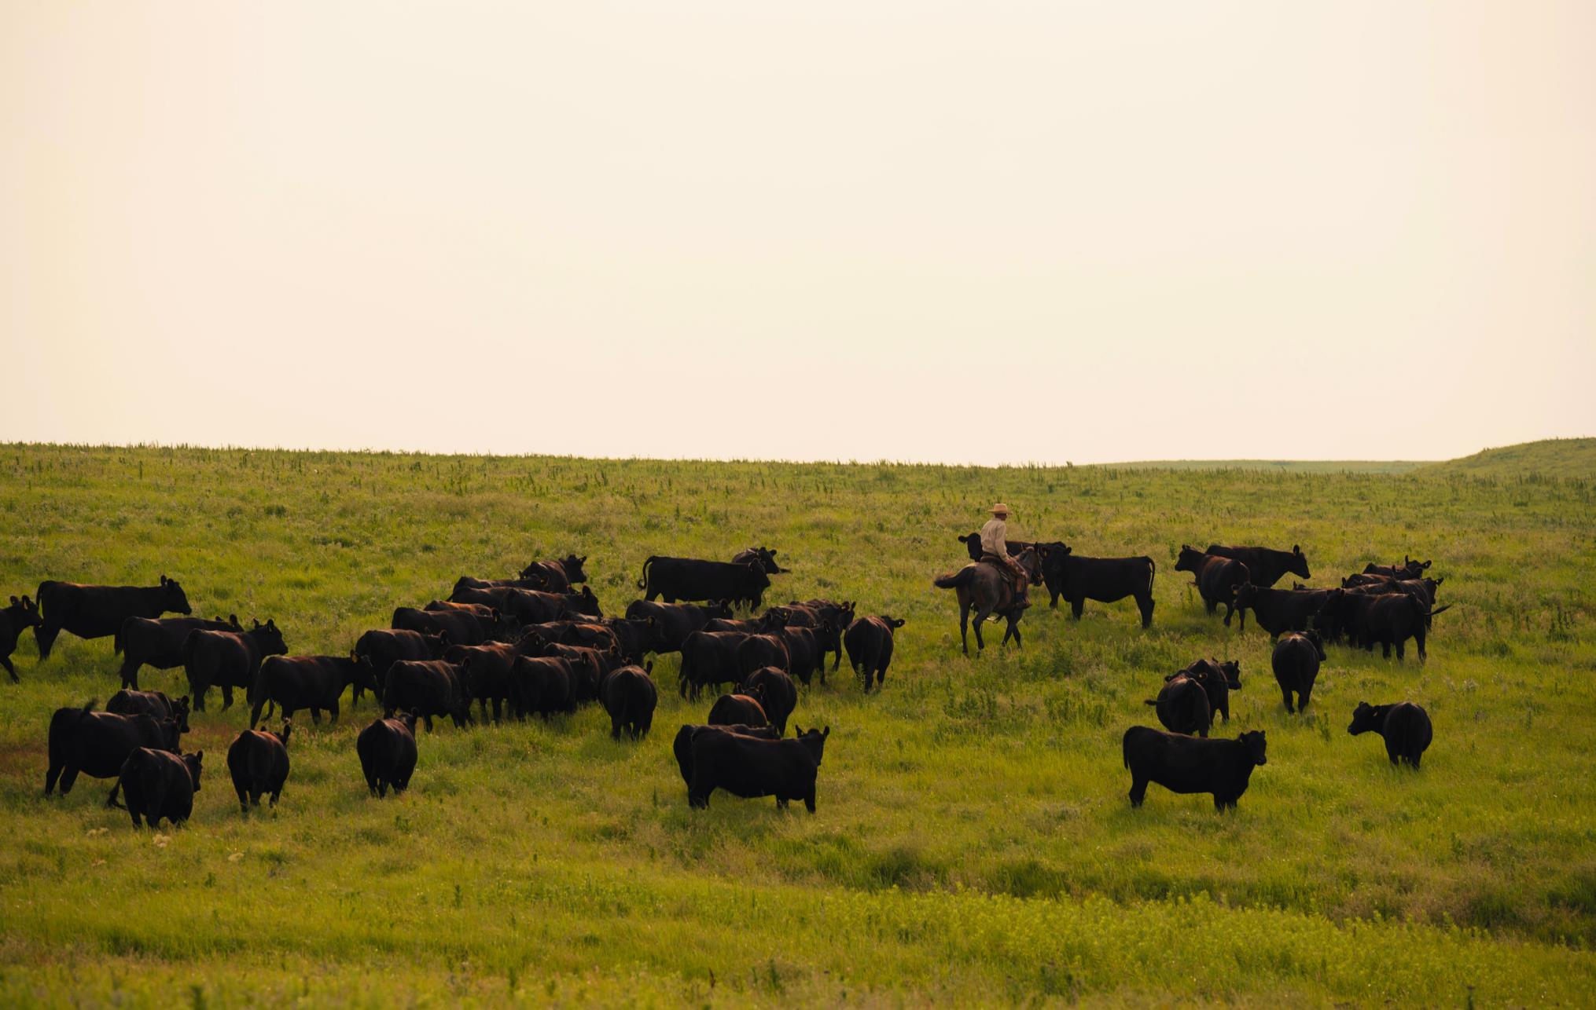
In the spring and summer, cattle eat grass in a pasture. A pasture is a field of grass.
Notes:
Pasture is grown specifically for animal use. Cattle graze on land that can’t be used for anything else because it is too steep or hilly for building houses, or too dry or too rocky for growing crops. Animals are the perfect use for it!

Slide 17
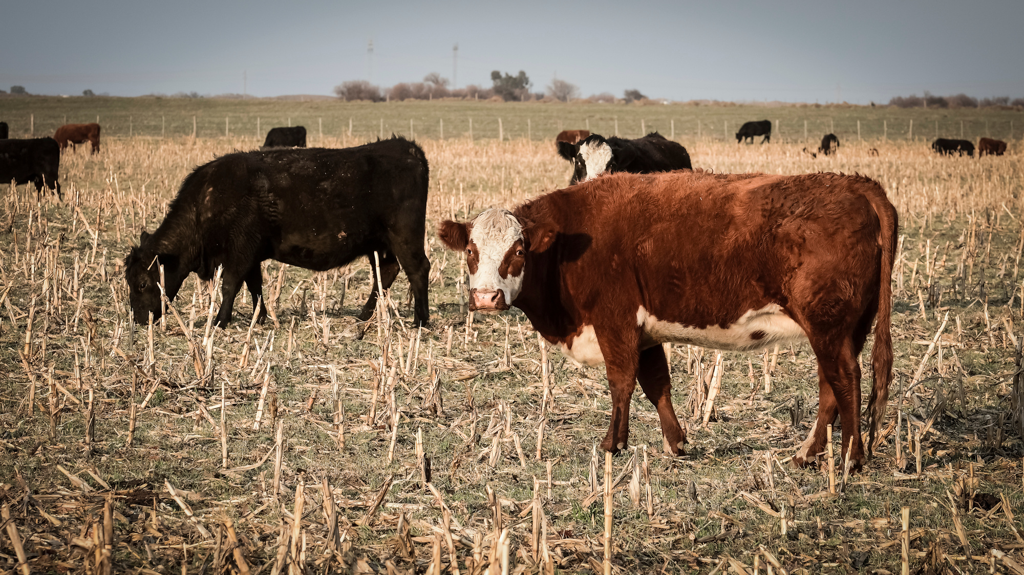
In the fall, cattle can eat cornstalks in the cornfields.
Notes:
Cornstalks are what is leftover after the farmer has used his combine to remove most of the corn.

Slide 18

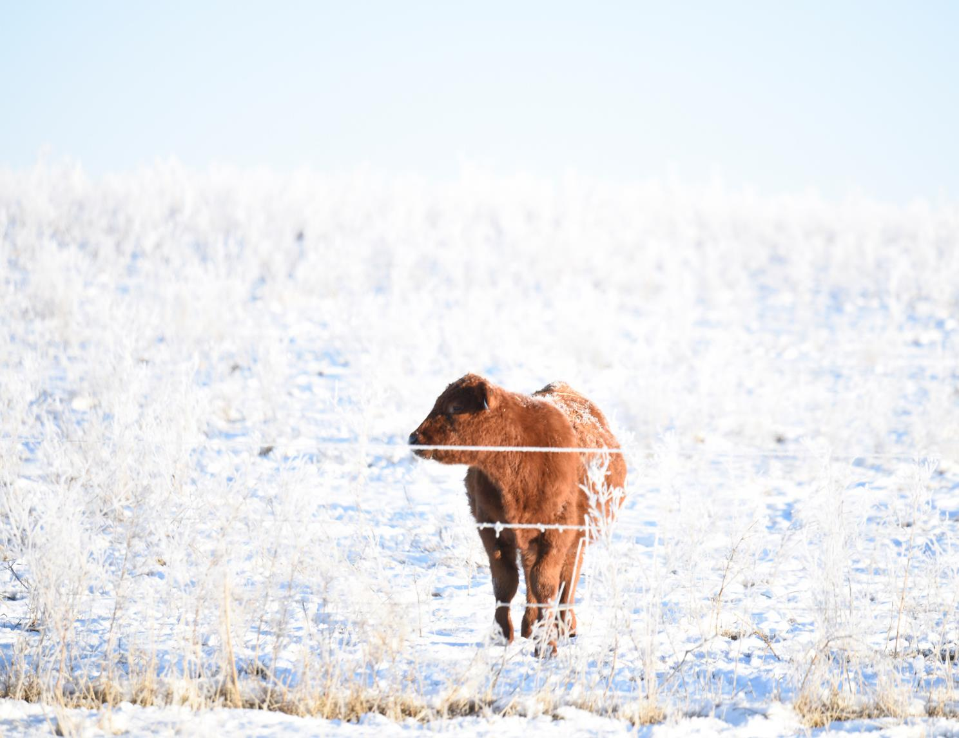
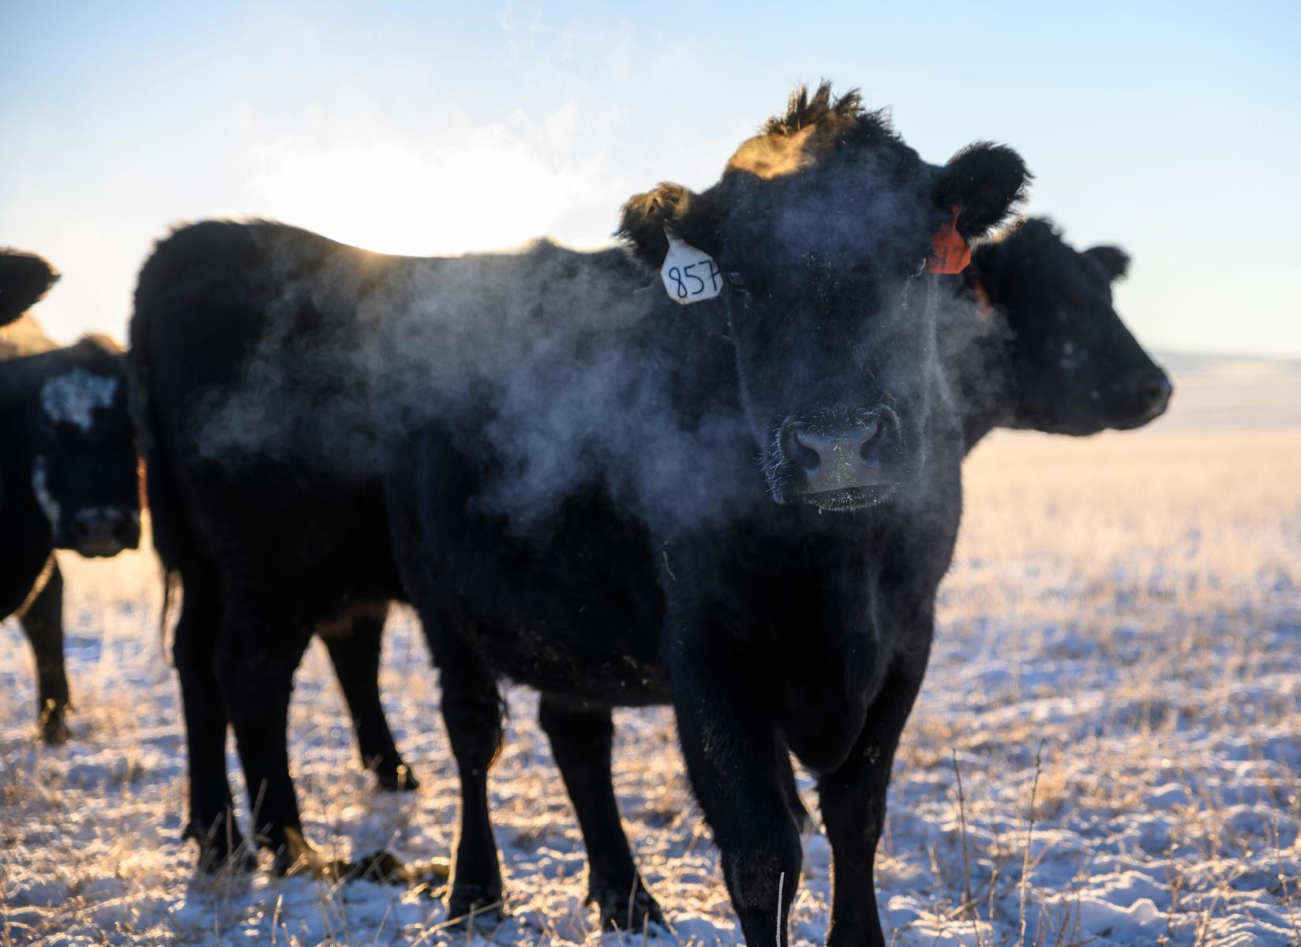
BRRR!!
Cattle can live outside all year long. Their hair grows thicker and longer in the winter to keep them warm.
Notes:
Cattle have a special coat of hair that protects them all year long. In the winter, their hair grows longer and is thicker to protect them from the cold temperatures and snow. And in the summer, their hair keeps them cool from the sun and warm temperatures. It is important for cattle to have protection from some of the weather elements. That is why there are trees, windbreaks and barns for the cattle to protect them from snow, wind, rain, and the sun.

Slide 19

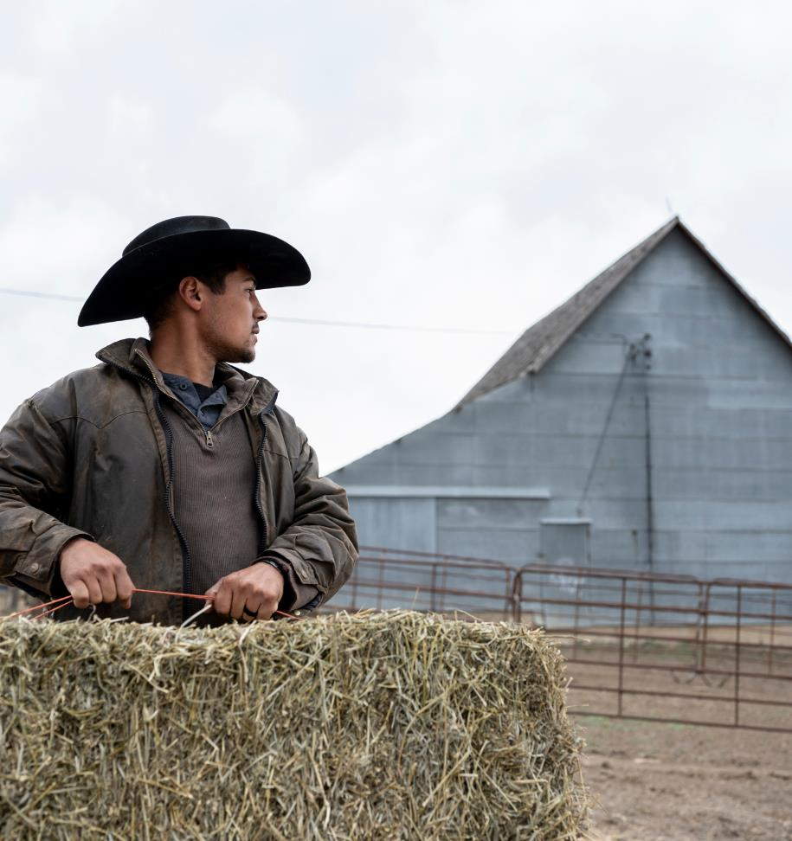
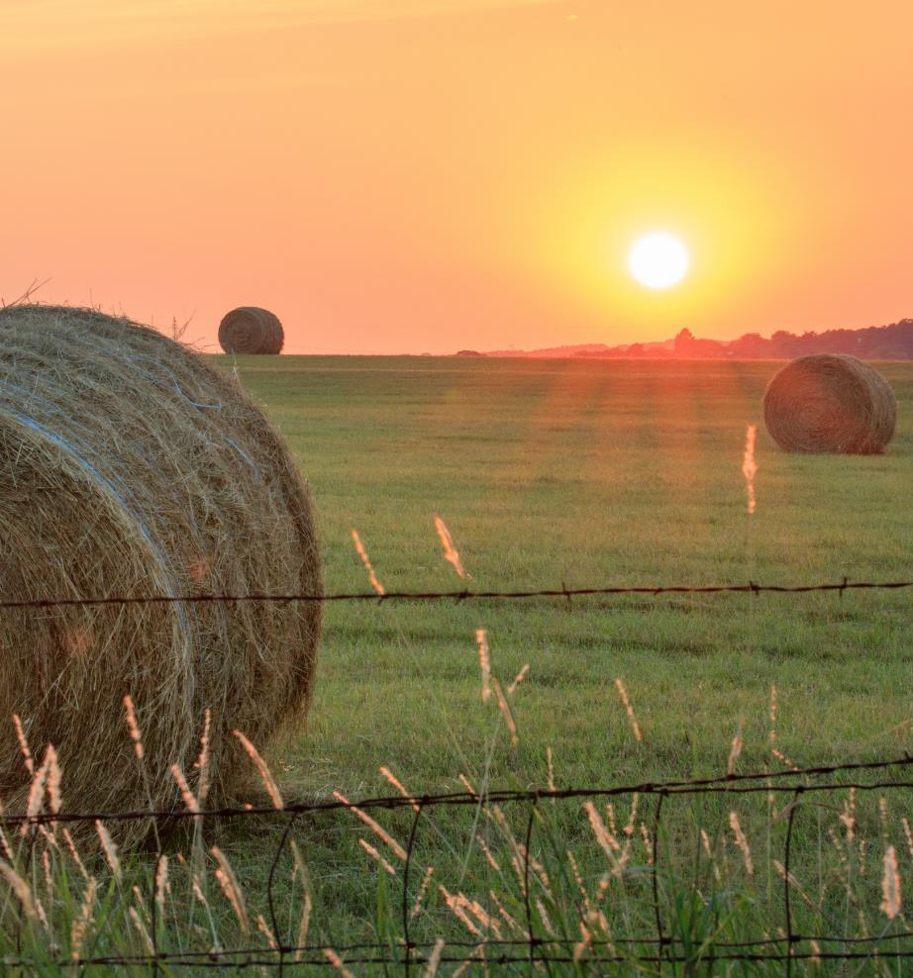
Farmers cut grass and hay and roll it into bales.
Cattle eat hay in the winter when no grass is growing.
Square Bale
round Bale
Notes:
How many of you have seen bales of hay in fields before? June, July and August is hay time on most cattle farms. Hay is long grasses such as alfalfa that have been cut and dried to use as animal food. Farmers cut the grass with a big mower and leave it to dry in the field for about two days. The dry hay is bundled into bales and stored in the barn. Round/Large bales weigh about one thousand pounds. A round/large bale is enough hay for a couple of days. They also eat grass because they are natural recyclers. Cattle eat lots of things that humans cannot.

Slide 20

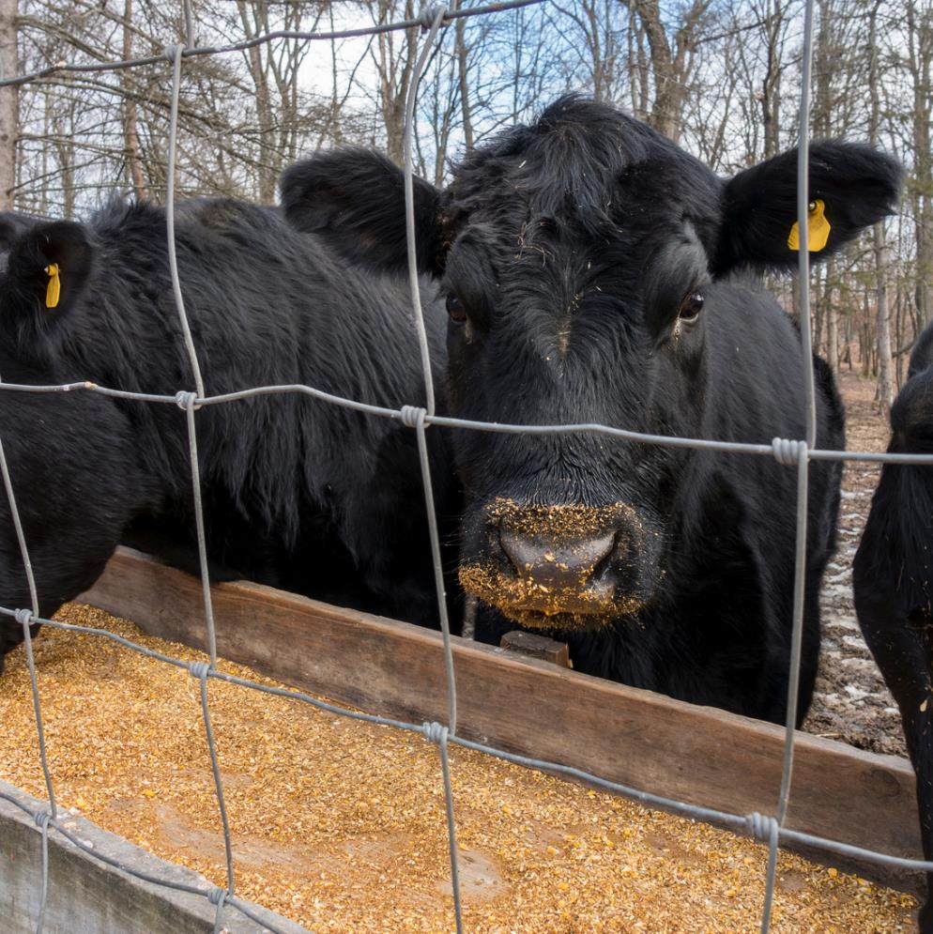
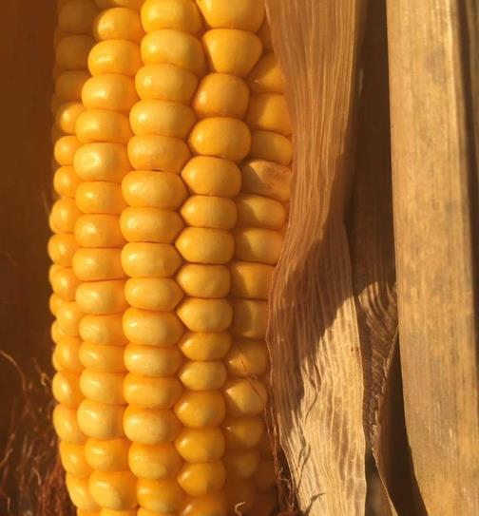
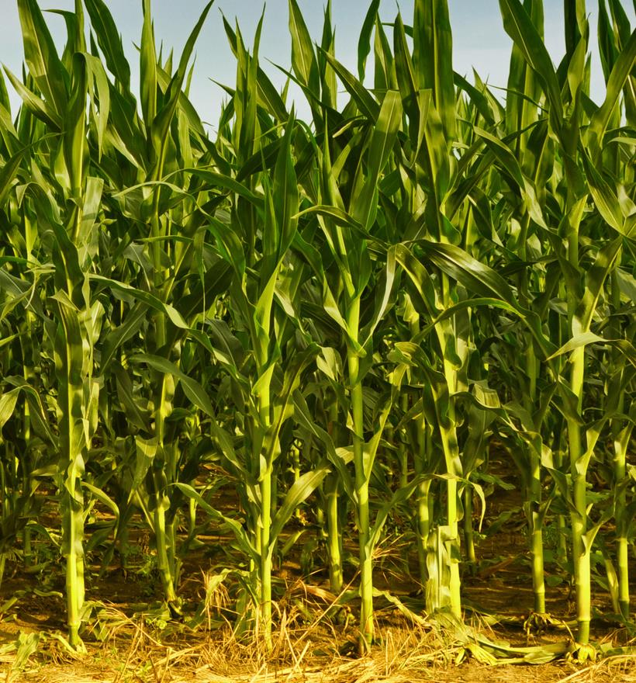
The farmer grows corn in cornfields to feed to cattle.
The corn is ground to make it easier to eat.
This corn is not like the sweet corn we eat.
Notes:
After calves are weaned, they go to a feedlot to eat more and grow bigger. Have any of you seen corn growing in the fields along the road? That corn is grown to feed animals, like cattle. It is harvested by the combine and then ground up for cattle to eat as grain. The corn that cattle eat is not like the sweet-corn that humans eat.

Slide 21

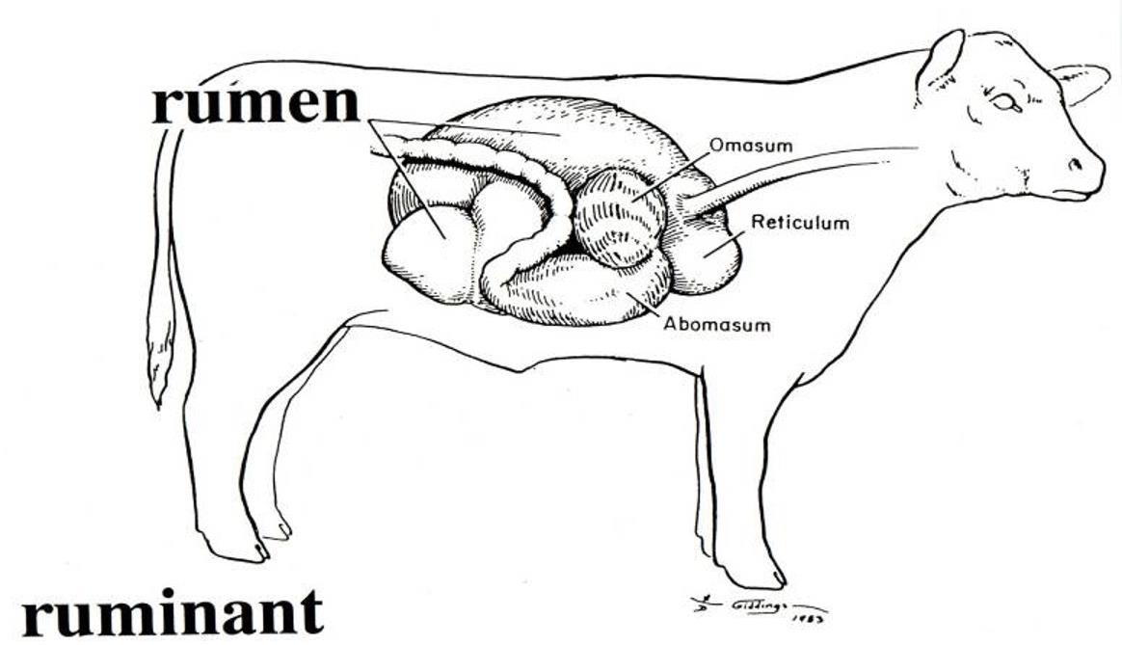

WOW! Cattle can eat grass, hay, and corn because they have a stomach with four parts. People can’t eat these things.
Notes:
The RUMEN can digest things like hay and grass that humans cannot.

Slide 22

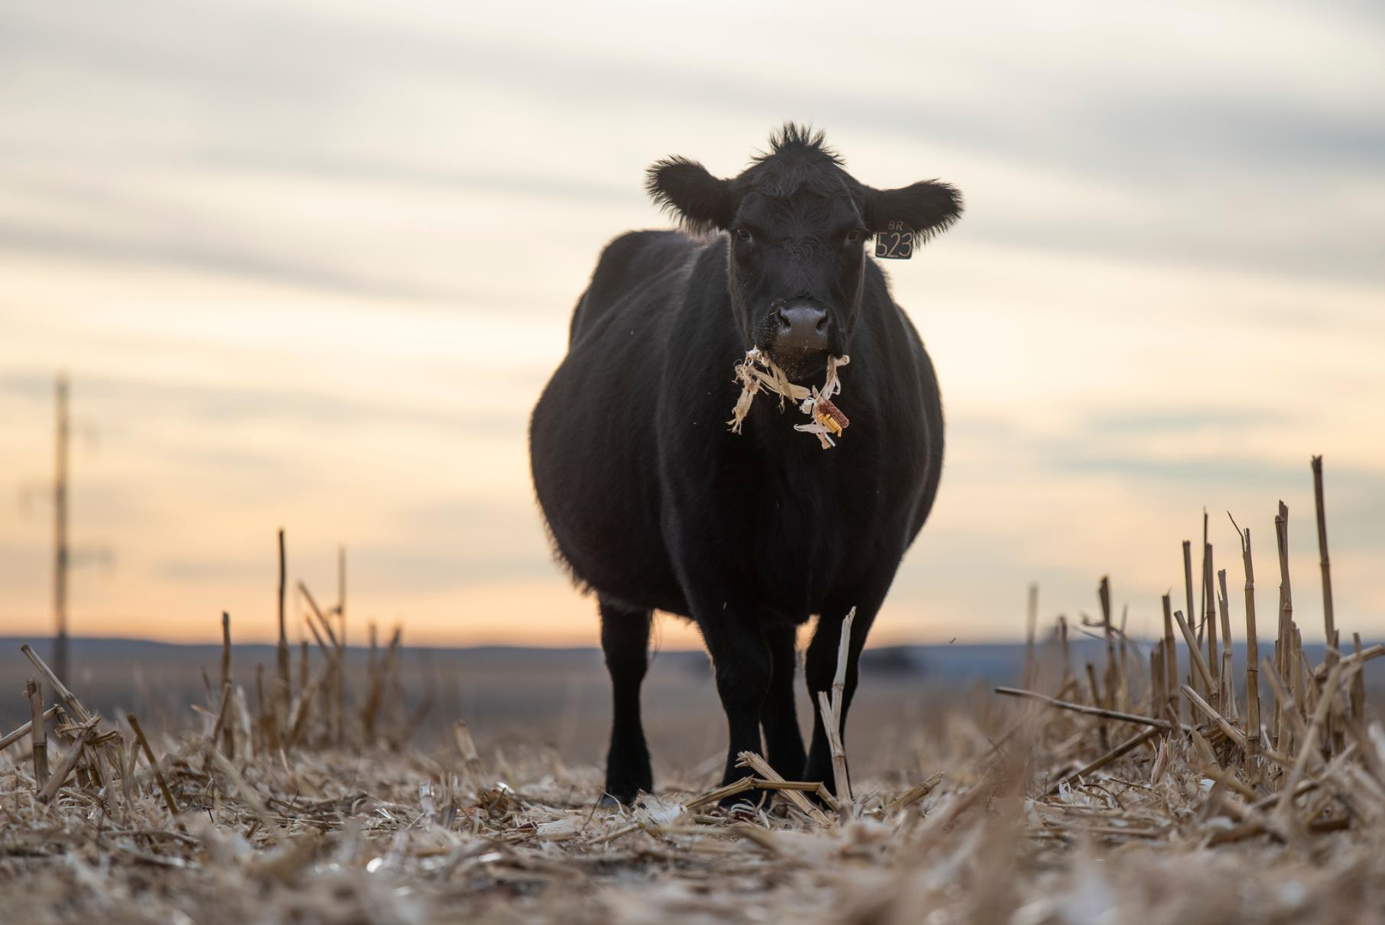
Burp!
Cattle eat their food, swallow it and then burp it up and chew it some more. This is called chewing cud.
Notes:
The burping action really does take place. In reality, cattle eat their food twice.

Slide 23

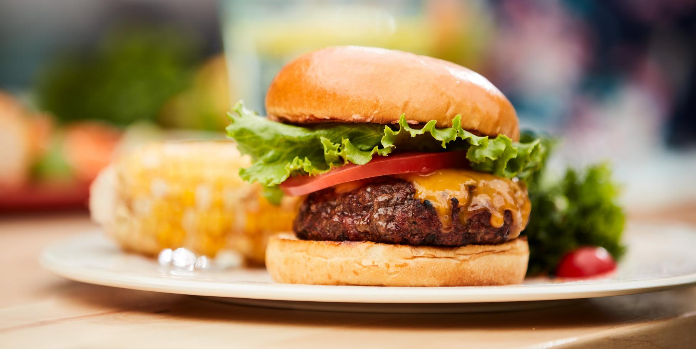


Cattle give us beef to eat, like this cheeseburger.
The meat comes from beef cattle.
The cheese comes from dairy cattle.

Slide 24

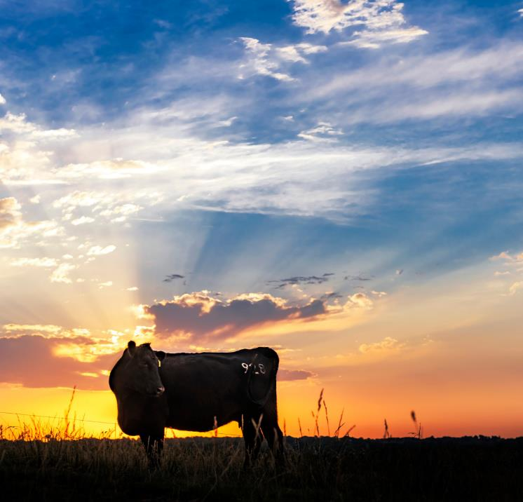
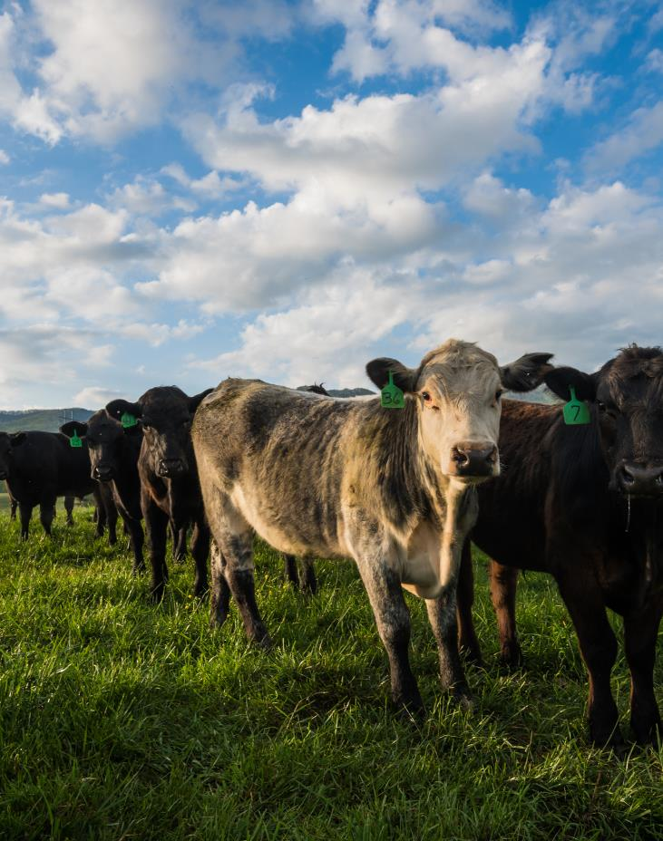
Now that you have learned about cows, you can say...
WOW
THAT
COW!
Notes:
Review key concepts:
Why do farmers raise cattle?
What do cattle eat?
Where do cattle live?
How do farmers care for cattle?

Slide 25

Brought to you by the
Iowa Beef Industry Council
Representing Iowa’s beef producers with
funding from the beef checkoff.
For more information:
www.iabeef.org
www.beefitswhatsfordinner.com

